Slide 1

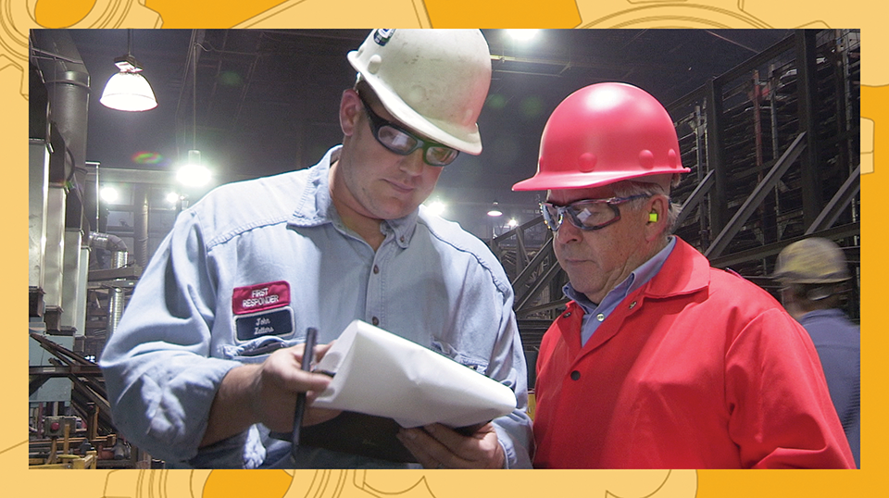
TRAIN THE TRAINER: SUPERVISOR
ORIENTATION TRAINING
WHAT ARE WORK BASED COURSES?
Notes:
Open section with introductions and goal setting.
Ask the employer representatives to
State their roles
Briefly describe their interest in the work-based course model, and their experience in other work-based learning activities
State goals for the training (overall)
Orient employer supervisors/mentors to work-based course model
Train supervisors/mentors in how to facilitate learning
Provide strategies for delivering instruction and documenting learning
Foster collaboration and partnership among industry employers and college faculty
NOTE: this first presentation is mostly definitional and designed to orient. Use this material to set the stage for the rest of the training.

Slide 2
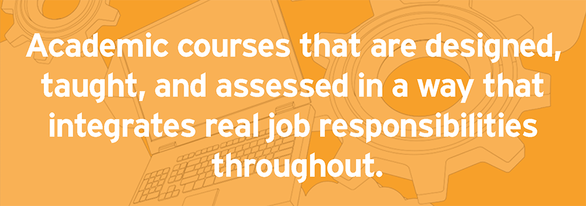
WORK-BASED COURSES ARE:
Notes:
Present the definition of work-based courses.
Ask participants how they think this may look in their worksites to generate conversation.

Slide 3
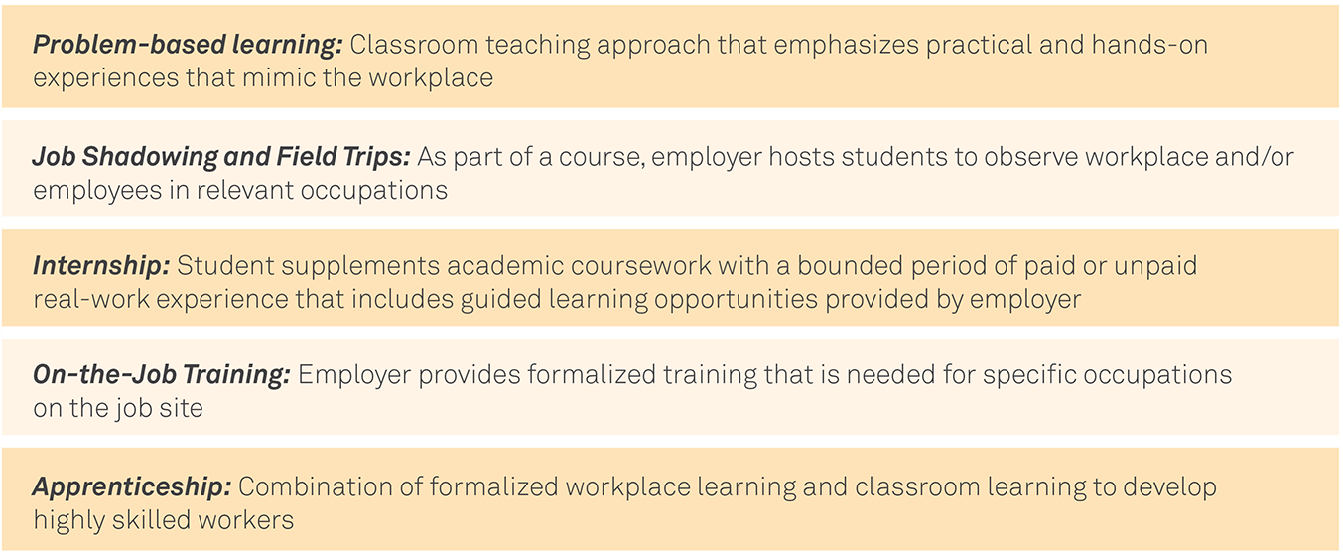
RELATED EXPERIENTIAL AND WORK-CENTERED LEARNING MODELS
Notes:
Present this continuum. Ask participants if they have participated in any of these models themselves, either as students or as supervisors.
Present work-based courses as situated in this continuum.

Slide 4
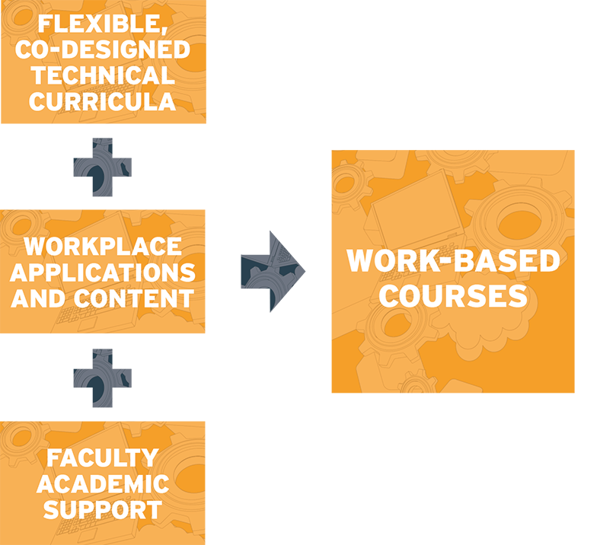

Slide 5
Why Are You Interested in Work-based Courses?
What Are the Benefits You See in Working
With Faculty in This Way?
Notes:
Use this opportunity to prime supervisors/mentors for the rest of the training. What stands out to them as interesting? Why are they involved? Does any of this mirror their own experience in school, internship, or co-op?

Slide 6
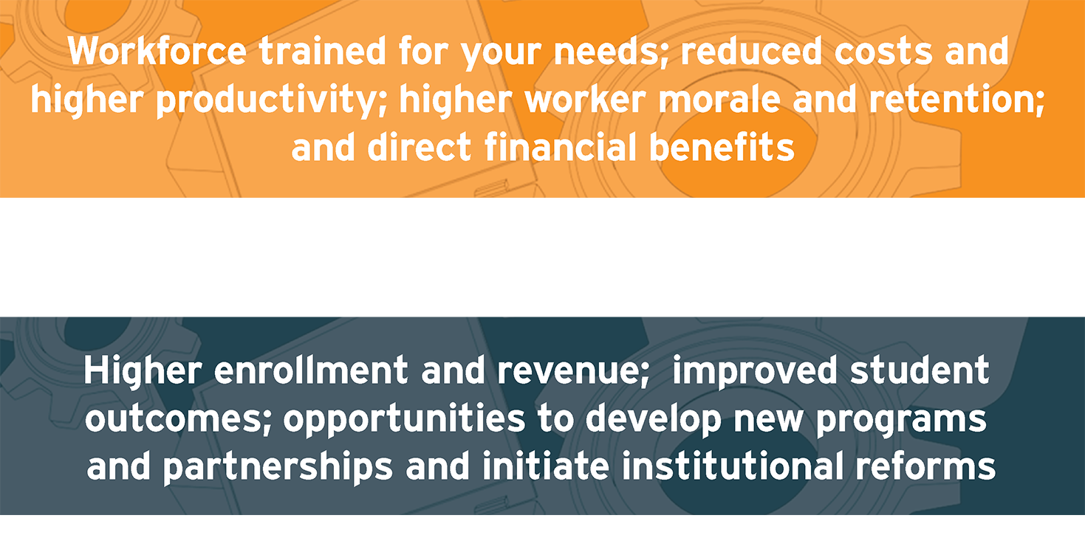
FOR EMPLOYERS
FOR COLLEGES AND FACULTY
Notes:
Faculty should be prepared to offer some insight as to why they are interested in this model, and why it can assist in their work developing workers.
Trainers should have some information to share about why companies have decided to join up.

Slide 7
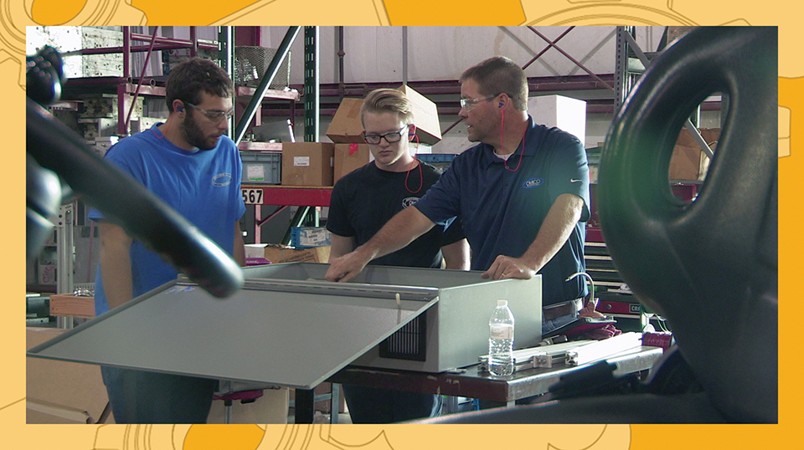
SUPERVISOR ORIENTATION TRAINING
THE WORKPLACE AS CLASSROOM: LINKING EXPERIENTIAL LEARNING WITH COLLEGE COURSES
Notes:
Part two:

Slide 8
Overview
TRAINING GOALS
Overview of adult learning and experiential learning
Coaching for self-direction and mastery at work
Using the workplace as a learning lab
Notes:
Present the goals for the second part of the training.
This presentation is centered on introducing the concept of the workplace as learning lab. This idea is central to work-based courses, and it is the main reason supervisors/mentors are being trained. It is important to note that supervisors are given a lot of responsibility in this model. Work-based courses are designed largely to harness their knowledge and experience in the workplace to deliver instruction, and you should note that supervisor are probably already doing some of this informally, but this training is designed to provide them with more tools and strategies to instruct more formally.

Slide 9
Adult Learning
Adult Learning Vs. Child Learning
What Are The Differences?
Learning On The Job Vs. In The Classroom
What Are The Advantages?
Notes:
NOTE: Adult learning is different!
We will provide an overview of adult learning theories and experiential learning, but this section should also draw out supervisors’ understanding of learning in general.
Suggestions:
Ask participants if they are parents. Ask what would be different if you were to teach your child something, vs. a worker in your plant?
How would you speak with a child vs. how would you speak with an adult?

Slide 10

THE ADULT LEARNER
Accomplishing work tasks
Fulfilling duties as assigned
AND
Establishing future goals (better productivity, work performance evaluations, promotions, etc.)
Notes:
Tying learning into work.
Adults learn as they accomplish tasks on the job.
They feel fulfillment when they have accomplished something assigned.
Also ties into advancement: the idea that learning at work can set an employee up for better performance, greater responsibilities, and potential advancement.

Slide 11
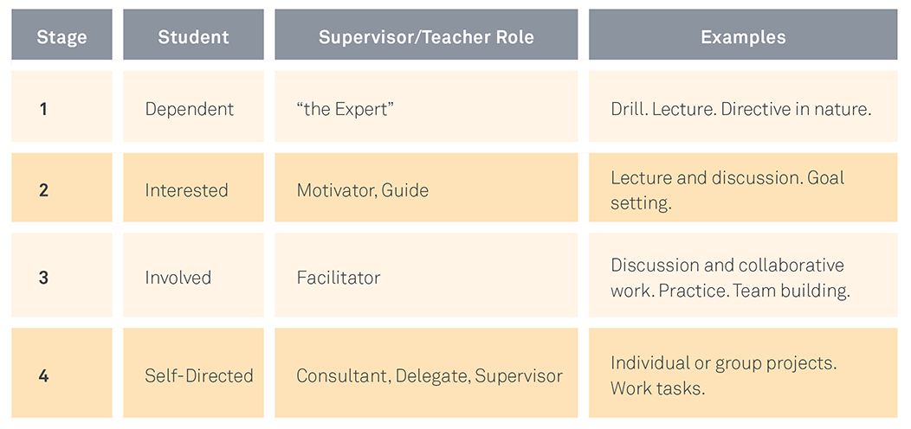
THE SELF-DIRECTED ADULT LEARNER
GROW’S STAGES IN LEARNING AUTONOMY
Grow, G. O. (1991). Teaching learners to be self-directed. Adult education quarterly, 41(3), 125-149.
Notes:
Grow’s stages are intended to show how work-based activities have applicability and immediacy in learning
Note how this connects to apprenticeships, and some forms of interning, where there are opportunities for Stages 3 and 4.
Work-based courses may be staged with some coursework and some lab work before the work-based learning occurs on site.
Here, connect the supervisor’s role to the teacher: as worker progresses, instruction shifts and the need for adapted learning techniques emerges. Note how when a worker is new at a task, the supervisor role is more directive. As the worker advances, the role of the supervisor becomes less directive and more facilitative: the student is more involved, and the supervisor is more of a guide. This is a continuum.

Slide 12
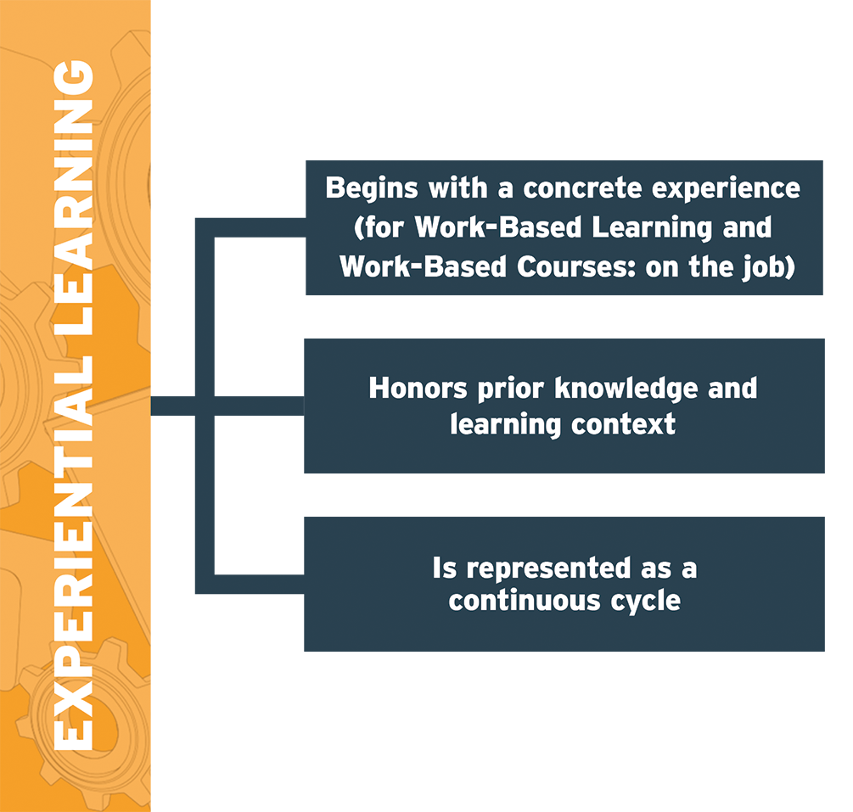
Notes:
Experiential learning: the heart of work-based courses.
Experiential learning shows how learning through doing is vital for on-the-job training, and it harnesses the power of experiences in the workplace to drive understanding and skill development. It is continuous, and draws on foundation knowledge.

Slide 13
EXPERIENTIAL LEARNING MODEL
KOLB’S SIX MAIN CHARACTERISTICS OF EXPERIENTIAL LEARNING:
Learning is a process, not a product.
Learning is continuous and grounded in experience.
Learning is full of tension; it requires effort to incorporate old and new experiences.
Learning is the process of one’s adaptation to an environment.
Learning involves engaging with one’s environment.
Learning is the process of creating understanding using social knowledge and personal knowledge, and workplace knowledge.
Notes:
David Kolb is a learning theorist who coined the term “experiential learning.” His work focuses on how students use experiences to drive understanding and skill development. This is particularly important for a work-based model, as students will be experiencing things on the job they have yet to learn in class; this is important, as it propels students along the cycle of doing, learning, practicing, and reflecting.
Read through some of these main points. Ask participants how they relate to their work with employees.

Slide 14
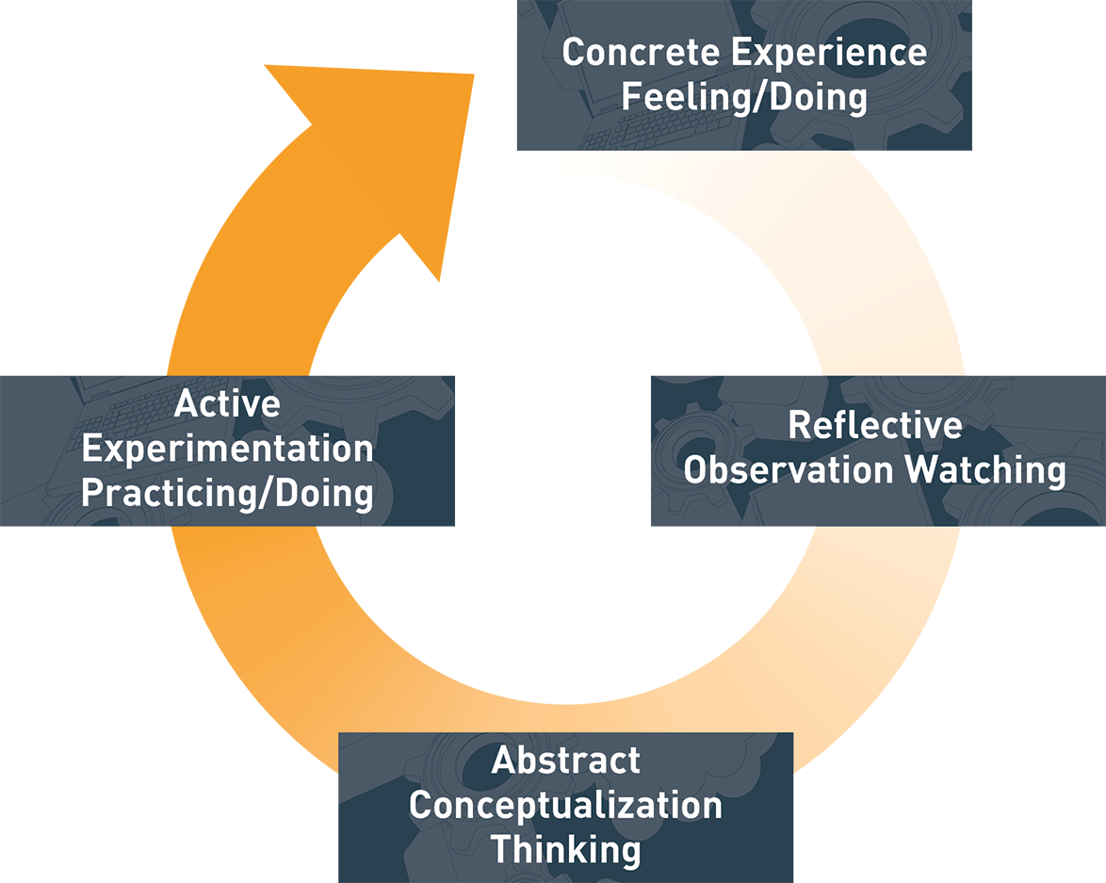
KOLB’S EXPERIENTIAL LEARNING MODEL
Notes:
Present this diagram, stress that it is a CYCLE and a PROCESS. Learning here starts with experiencing something, then reflecting while watching someone perform a task, then thinking about how it is connected and what it entails, then practicing the skill for themselves. This cycle is explicit, and may seem like it is drawn out (many times on the job, this cycle happens very quickly!), but, it is important to note that this is how learning takes place and making this explicit with supervisors will allow them to understand where a student falls on the cycle at any given point.

Slide 15
LINKING EXPERIENTIAL LEARNING WITH COLLEGE
ASSUMPTIONS DRIVING WORK-BASED COURSES:
Workers need to see college as attainable and relevant
Workers need to see the path to goals (future opportunities in the company, expanded skills)
Learning through experience (both new and old) makes sense of a work context
Notes:
Connecting learning on the job to college:
Ask participants if these assumptions ring true. Do they think that student workers need to see college as attainable, and see a path to their future? How could this improve worker performance?

Slide 16
LINKING EXPERIENTIAL LEARNING WITH COLLEGE
DISCUSSION QUESTIONS:
How is the workplace a learning lab? What role does the worksite play in shaping learning experiences for adults?
How can learning on site help benefit your company?
How can you balance the needs of the production cycle with opportunities for workers to learn?
Can learning on the job shape expectations for college going? How can this help the manufacturing industry meet new challenges?
Notes:
Present these as discussion questions. (See facilitator’s guide in Section 4, and especially the discussion strategies in Tool 4-3.)
Formats could include:
Think-pair-share
Group discussions

Slide 17
LINKING EXPERIENTIAL LEARNING WITH COLLEGE
QUESTIONS ABOUT WORK-BASED COURSE MODELS:
How can work-based courses encourage adults to continue their formal education?
Why is learning on the job more attractive to adults? Why might it be particularly appealing to workers in the manufacturing industry?
How can industry use work-based courses to build its workforce?

Slide 18
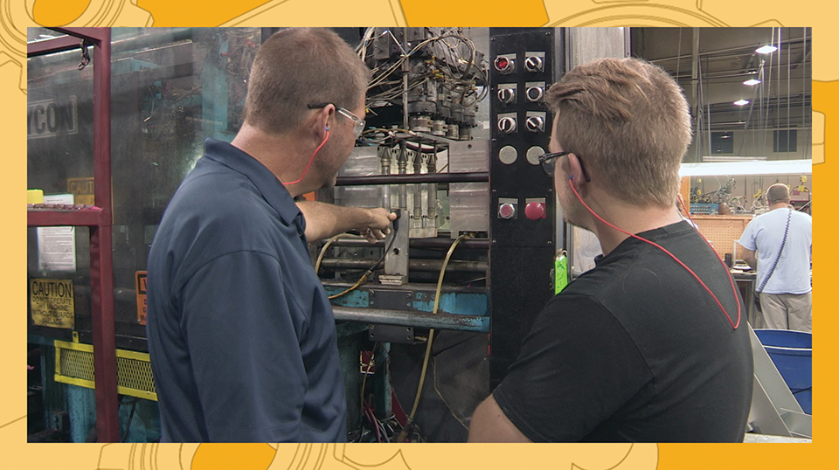
SUPERVISOR ORIENTATION TRAINING
DESIGNING A WORK-BASED COURSE: A CONVERSATION
Notes:
This section will be delivered in a facilitated conversation format.
At tables, have companies work together with a faculty facilitator to discuss and answer the following questions. Faculty facilitators will take notes and share with the group high-level takeaways.
The goal of this section is to provide an opportunity for supervisors to share their experience so far, discuss aspects of the model, and discuss the process for design.
These questions are prompts, and many conversations will expand on these or omit some as they see fit. Use this content to inform how you deliver the rest of the training.

Slide 19
CRAFTING YOUR WORK-BASED COURSE MODEL
What Does The Program Look Like At Your Company?
How Did It Get Started?
Did You Have A Company “Champion”?
How Does The Model Work, Who Does What,
And How Has It Evolved?

Slide 20
CRAFTING YOUR WORK-BASED COURSE MODEL
How Did The Task Analysis Provided By The College
Help Your Company Envision A Work-based Course?
What Was Particularly Useful Or Illuminating
About This Process?
What Were Your Goals In Implementing
A Work-based Course Model?
What Are Your Impressions So Far? What Works,
What Doesn’t?

Slide 21
Crafting Learning and Work Objectives
How Do You Determine Learning Objectives On The Job?
How Do You Balance What The Worker Needs
To Know Now, Vs. What He Or She Should
Learn In The Future?
How Do You Balance Work Demands
And Student Learning Goals?

Slide 22
Coaching for Employee Success
How Would You Describe Working With
Your Employees In This Model?
How Do You Coach For Performance? How Are You
“Creating Your Own Workforce”?
How Do You Balance Work Demands
And Student Learning Goals?

Slide 23
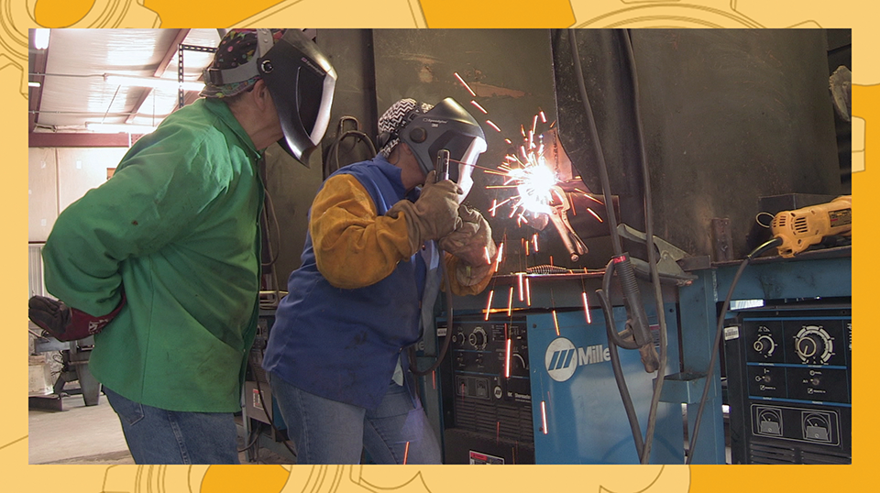
SUPERVISOR ORIENTATION TRAINING
INSTRUCTIONAL STRATEGIES FOR EXPERIENTIAL WORK-BASED COURSES

Slide 24
TRAINING GOALS
Qualities of a motivational supervisor/instructor
Harnessing student motivation
Instructional strategies for experiential learning on the job
Notes:
Present the Training Goals:
This section is designed to outline the qualities of an effective supervisor, discuss student motivation, and introduce instructional strategies for the workplace.

Slide 25
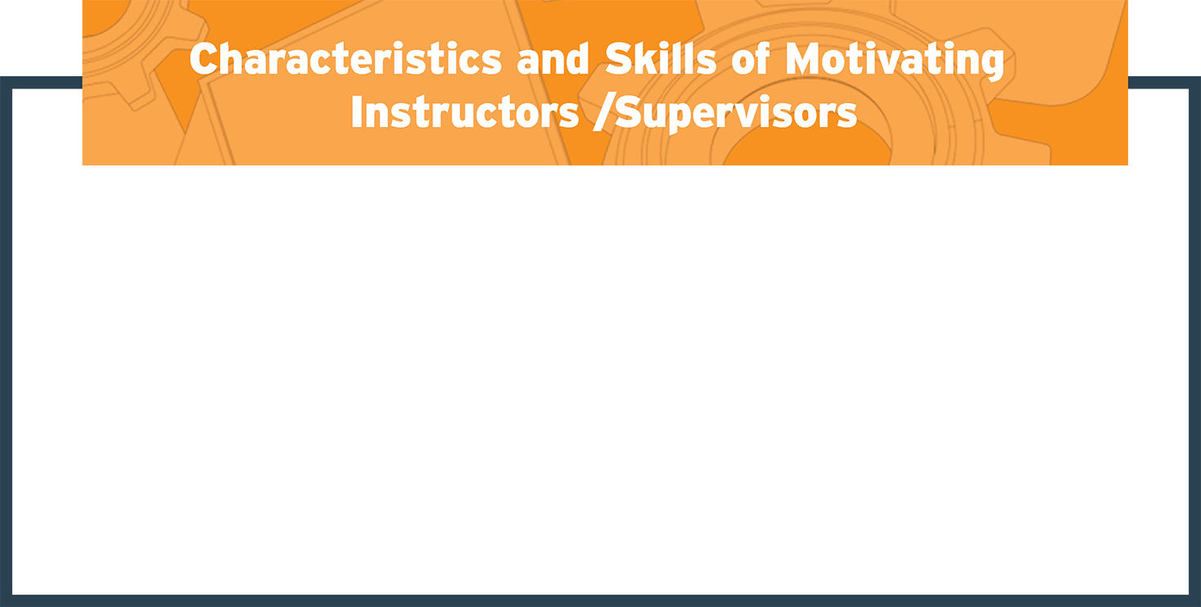
SUPERVISORS AS INSTRUCTORS
Expertise
Empathy
Enthusiasm
Clarity
Wlodkowski, R. J. (2011). Enhancing adult motivation to learn: A comprehensive guide for teaching all adults. John Wiley & Sons.
Notes:
What makes a skilled supervisor or mentor?
Expertise: Knows something valuable, knows it well, is prepared to convey it
Empathy: Has realistic understanding of learner’s needs and expectations, has adapted instruction/supervision to the learner’s level, considers the learner’s perspective
Enthusiasm: Committed and cares about what is taught, expresses energy and interest in the subject (mentoring, modeling behavior)
Clarity: Uses the power of language, can be understood, provides opportunities for learners to understand something if not clear from the beginning
Note how each supervisor was chosen by their company for this role. Discuss why this vote of confidence is important, and what it means for their work with students. Highlight this role as a POSITIVE.

Slide 26
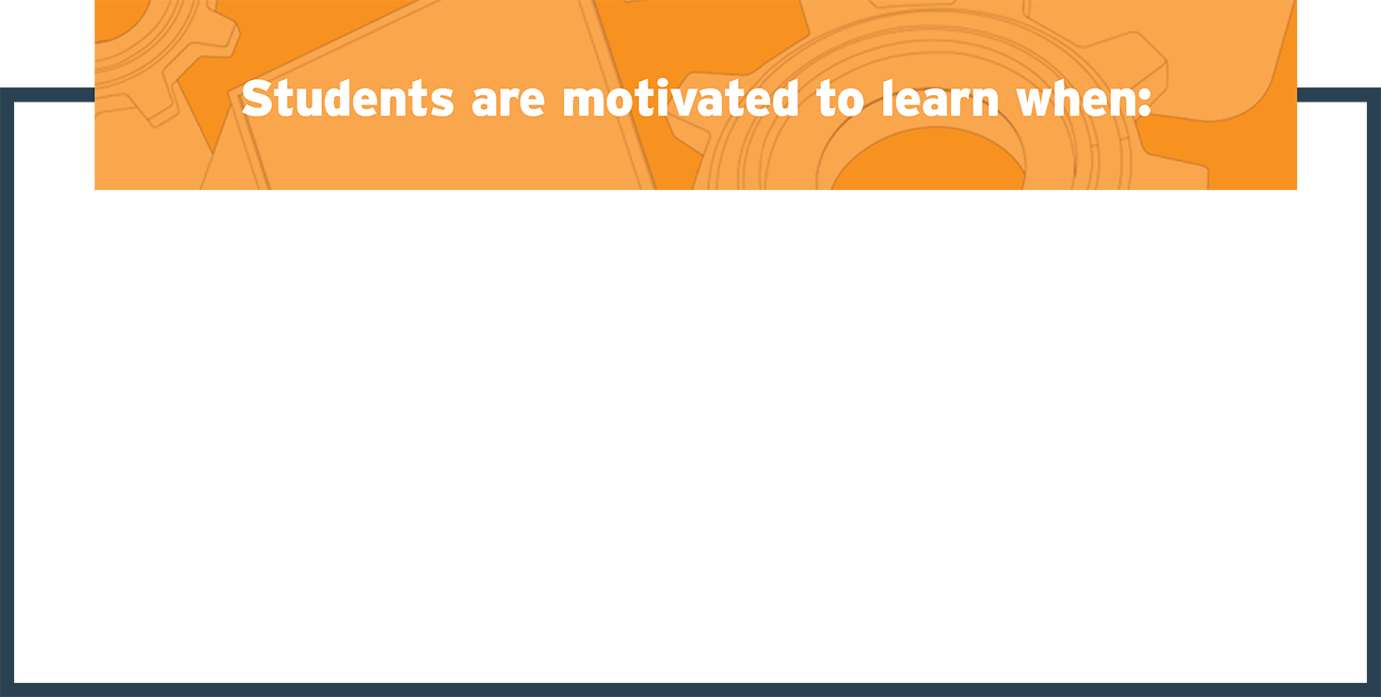
ENCOURAGING STUDENT MOTIVATION
Objectives are clear and well-defined
Learning is situated in a real-world context
Learning is connected to immediate AND longer-term goals
Learning is practiced and reinforced
Progress is apparent and feedback is shared
Notes:
Flip side of motivating supervisors: motivating conditions for workers
Adult students (especially at work) are more motivated because their learning is tied to their current work.
Supervisors can leverage this motivation on the job for job quality. If a worker is invested, and sees that their company is invested, they are more likely to perform at a higher level.
You can “grow your own workforce” this way.

Slide 27
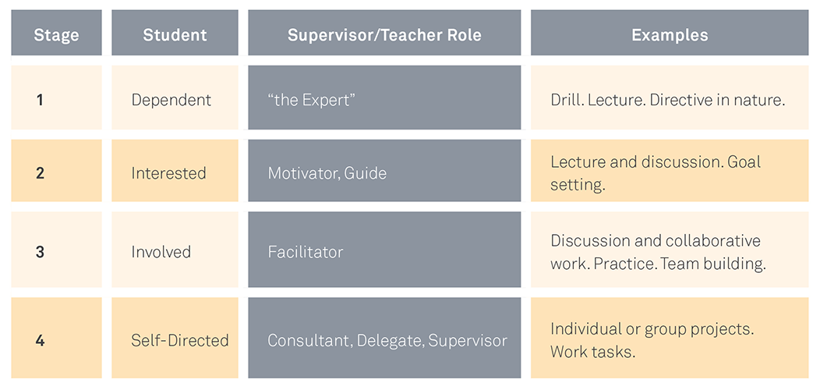
ENCOURAGING STUDENT MOTIVATION AND AUTOMOMY
Notes:
Reintroduce stages of learning autonomy matrix.
Remember motivation, and how it evolves. If your goal is to reach the self-directed learner, then scaffold your content. As the learner progresses, so too do your tactics in instruction and coaching.
Ask participants how they can tell if a worker is progressing. How do they determine if a worker is ready to complete a task on his own?

Slide 28

KOLB’S EXPERIENTIAL LEARNING MODEL
Notes:
Reminder of Kolb’s learning model.
Instruction at each part will need to reflect its place in the cycle.
Experience
Demonstration
Thinking/processing
Practice

Slide 29

Experiential Learning in the Workplace
CONCRETE EXPERIENCE:
Experiential learning here begins with a concrete, tangible experience on the job (performing a job task, for example). Activate student background knowledge so it “feels real” to them. This is the “what” of the lesson.
Notes:
Important to highlight multiple ways of presenting knowledge. (Telling, showing, demonstrating with visuals, etc.)
Was this skill or concept taught in the classroom already? Are students familiar with it? Activate background knowledge and stimulate thought.
Prompt participants: What stage of learner (Grow’s learning autonomy) is this?
Discussion Questions
How do you introduce concepts on the job? Have you ever had an employee be able to do something, but not explain why or how they have done it?

Slide 30

Experiential Learning in the Workplace
REFLECTIVE EXPERIENCE:
It is important for students to reflect on what they have experienced and begin to internalize the lessons. In this phase, workers should be encouraged to ask questions for clarification. This gets to the “why” of the lesson.
Notes:
Highlight questions to ask: What did I just demonstrate? What did you see? What steps did I take to complete this task?
Prompt participants: What stage of Grow’s learning autonomy is this? How is it experienced by the student?
Discussion Questions
How do you allow for reflection in the workplace? Do you encourage students to ask questions? Do they work as a group and learn from their peers?

Slide 31

Experiential Learning in the Workplace
ABSTRACT CONCEPTUALIZATION:
The student worker should be able to understand what is being taught, and why, and begin to form the “how-to.” This is where the conceptual understanding begins and the student takes ownership of the skill or task. Troubleshooting and critical thinking are developed more fully here.
Notes:
Troubleshooting and critical thinking are essential for the workplace. Ask questions for understanding. Why did I do this step? What would happen if I didn’t do this or that?
Prompt participants: What stage of Grow’s learning autonomy is this?
How does this phase (conceptualization) relate to Knowles’s concept of internal motivation in adult learners?
Discussion Questions:
How do you check for conceptual understanding? Do you have workers troubleshoot a problem? If something goes wrong, how do you check to see if they understand what could have happened differently?

Slide 32

Experiential Learning in the Workplace
ACTIVE EXPERIMENTATION:
In this phase, students will be able to apply what they have learned and practice. Having students show you what they have learned is crucial to putting it all together. This is the what, why, how, and the concrete application of a skill.
Notes:
Highlight practice and the need to show learning. How can students practice? In a group? Individually? Does this happen “on the line” or is it separate?
Prompt participants: What stage of Grow’s learning autonomy is this?
Discussion Questions:
How do you ask workers to show you how they know something? How do you know when they have mastered the skill? How many times, and how many ways do they need to demonstrate their knowledge?

Slide 33

SUPERVISOR ORIENTATION TRAINING
ACCESSING WORK-BASED COURSES AND EXPERIENTIAL LEARNING

Slide 34
OVERVIEW
Qualities of effective assessments
Assessing learning at varying stages
Putting together a “portfolio” of assessments
Using rubrics and documenting performance on the job
Notes:
Introduce training goals.
Here, we focus on documenting and assessing learning. This piece is crucial for work-based courses, as much learning on the job occurs organically, but documenting this is the key to formalizing the on-the-job piece.

Slide 35

ASSESSING LEARNING ON THE JOB
How do you know when your workers know how to do something correctly?
How do you know when to provide more rigorous work or opportunities for your workers?
Notes:
Questions: delivered in a think-pair-share manner.
Ask pairs to report out briefly.

Slide 36
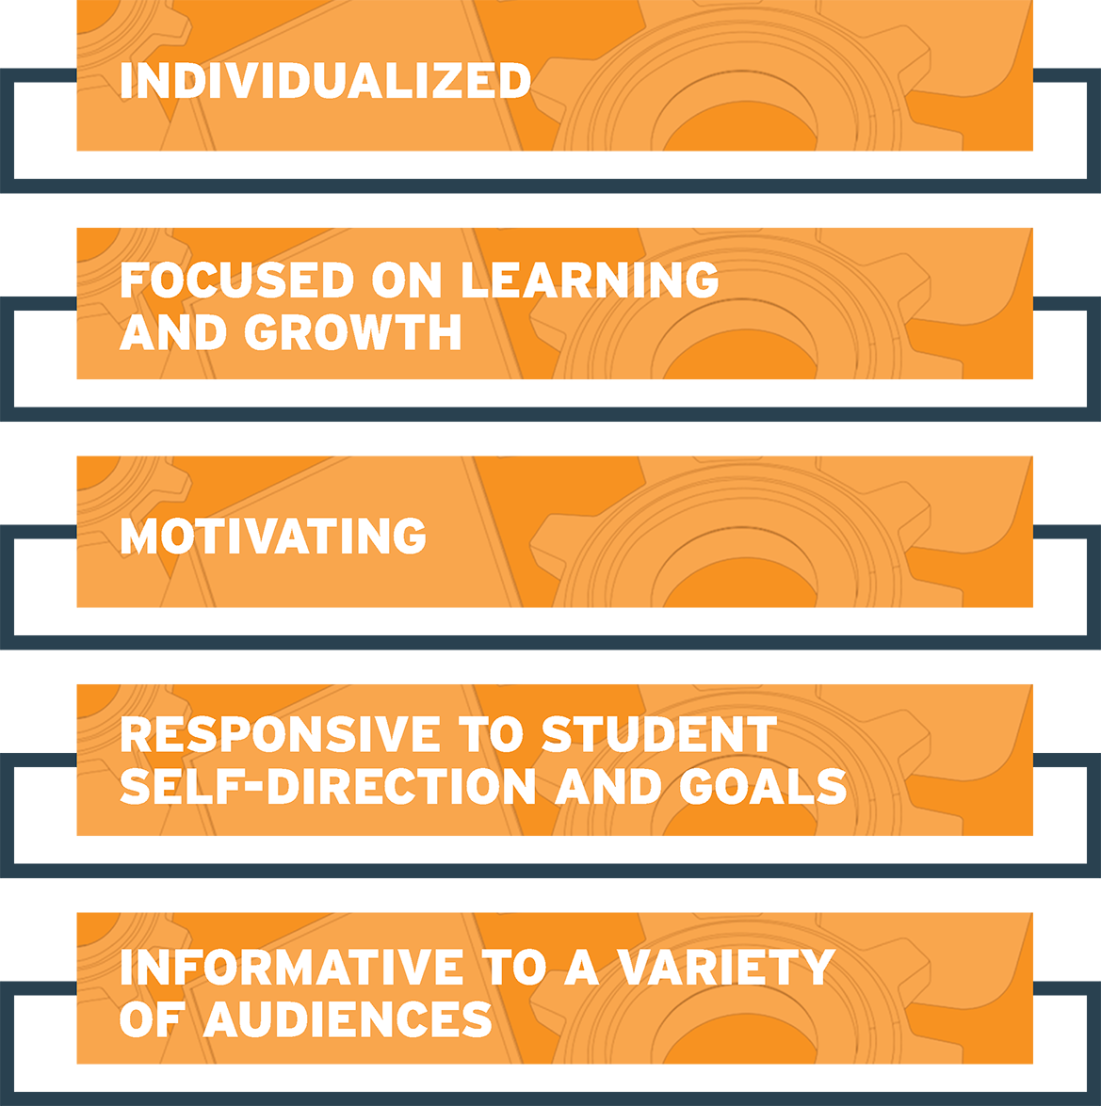
QUALITIES OF STUDENT-CENTERED ASSESSMENT
Andrade, Heidi, Huff, Kristen, and Brooke, Georgia. Assessing Learning: Students at the Center Series, Jobs for the Future, 2012. Retrieved from http://www.studentsatthecenter.org/topics/assessing-learning
Notes:
Assessments are vitally important to the work-based course model. Because learning happens at both the workplace and in the classroom, both faculty and employer supervisors and mentors will need to comfortably assess for learning in multiple contexts and share those assessments with multiple audiences.
According to the research from Jobs for the Future’s Students at the Center project, there are five main qualities of student-centered and well-developed assessments. Please note: not all individual assessments will possess every quality, but a full assessment approach in an entire work-based course should reflect these qualities at some time.
They should be individualized, and designed to capture the learning needs of individual workers.
They promote learning and growth by providing detailed feedback and information about student strengths and areas for development.
They should motivate workers by leveraging student interest and experiences.
They should actively engage students and promote learning autonomy. Student workers should be involved in goal setting and measuring their own progress, which promotes learning autonomy and “ownership.”
They should be designed so information gathered on worker progress can be used to improve curricula or instruction, as well as individual worker progress.

Slide 37
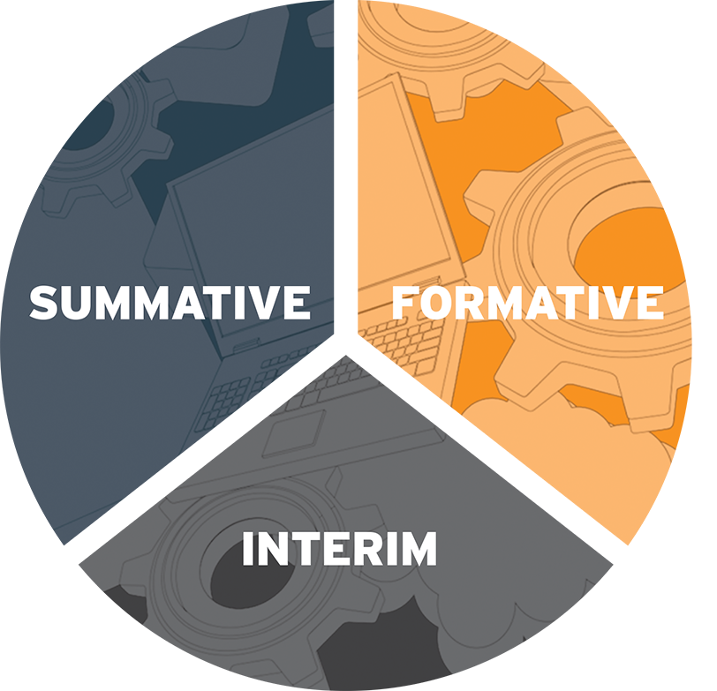
CONTENTS OF A COMPREHENSIVE ASSESSMENT PORTFOLIO
Notes:
Types of assessments:
Formative: Assessments for learning. These assessments are designed to provide information on student learning, including both abilities and areas for development. Examples include portfolio samples, peer assessments, or completed task lists.
Summative: Assessments of learning. These assessments are designed to take a full measure of what a student knows at a given time (typically at the end or the start of a course, unit, or lesson). They include diagnostic tests, projects (by way of rubrics), or credentialing exams.
Interim: Mixture of both types, often employed to benchmark progress and determine if the student is on track. These assessments are often criterion-referenced (meaning they are meant to measure worker performance against a set of determined standards or criteria).

Slide 38
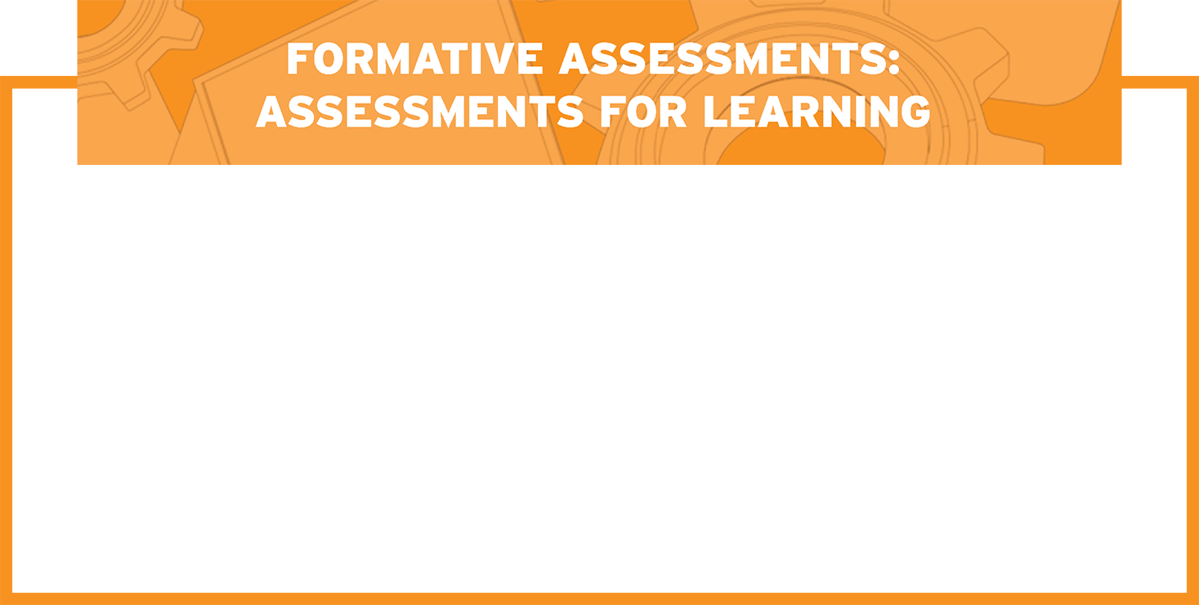
FORMATIVE ASSESSMENTS EXAMPLES
Documentation
Self-assessments
Peer assessments
Supervisor feedback
(written mentor notes, rubrics)
Notes:
Introduce these concepts:
How do you document learning? What checklists or other documents do you currently use?
How often, if at all, do you ask workers to assess themselves? What forms do you use?
How often, if at all, do you ask peers or other supervisors for their feedback on workers?
How do you relay feedback to your workers? How detailed is this feedback? Do you offer suggestions on how to do things differently, or offer any encouragement if you see a worker struggling?

Slide 39
DISCUSSION QUESTIONS: FORMATIVE ASSESSMENTS
How many of you already integrate formative assessments in your work?
If you use peer or self-assessments, how do you collect this information?
How do you see formative assessments fitting work-based learning? If you do not conduct these now, how will you integrate these?
Notes:
Group discussion. What is currently in place for these assessments? How do you record this information?
How can collaborating with college faculty help with this? What would you need from college faculty to gather this information more concisely?

Slide 40
INTERIM ASSESSMENTS EXAMPLES
Quizzes or Drills
Task lists
Demonstrations/Practice
Notes:
These assessments are more formal, and designed to take a snapshot of current abilities.
How can these be delivered on the job? If they are not delivered on the job, how can they be delivered at the college and how could supervisors use this information?
How can college faculty communicate the results of the assessments from the classroom to supervisors?

Slide 41
Discussion Questions: Interim Assessments
DISCUSSION QUESTIONS: FORMATIVE ASSESSMENTS
How do you use formative assessments in your work? What do you do?
How could you use the data from these interim assessments to inform your work as a supervisor/mentor?
How will you use these practices to collaborate with community college faculty?

Slide 42
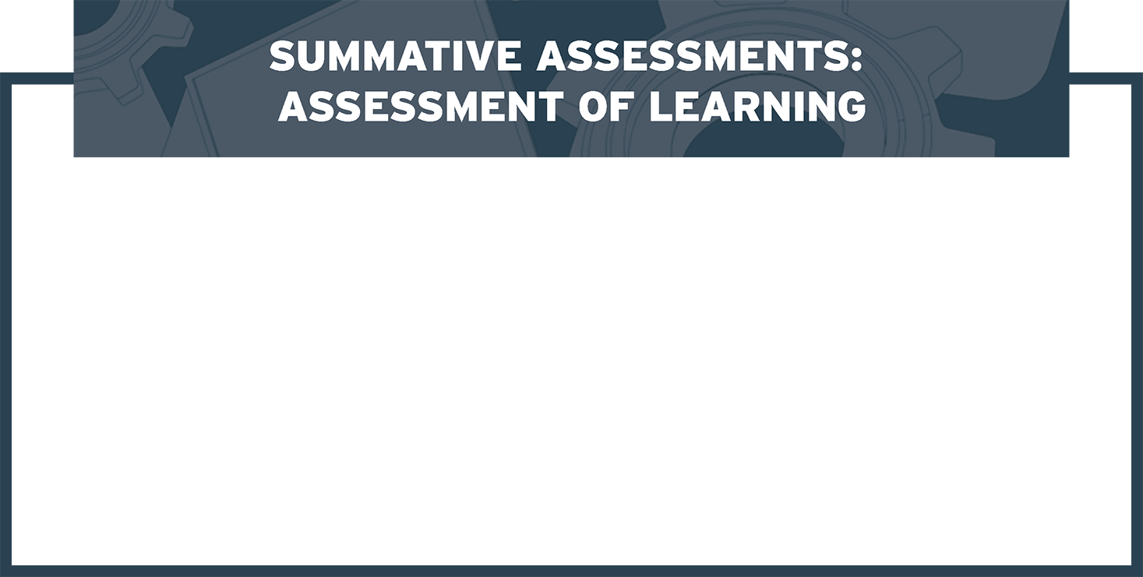
SUMMATIVE ASSESSMENTS EXAMPLES
Standardized or credentialing tests
Collaborative work
Production goals
Notes:
Summative assessments should be used at the end of a major learning event (a unit in a course, for example).
How could a skill be assessed on the job? If faculty have signaled that a worker is ready to demonstrate this skill on the job, how can supervisors test this?
This is a tricky part, and will need much discussion: what constraints exist on the worksite that prevent workers from performing certain skills? What assurance is needed for the company? What opportunities exist for practice in this way?

Slide 43
DISCUSSION QUESTIONS: SUMMATIVE ASSESSMENTS
How could you use summative assessments in your work?
What instruments could you use? Could you use these instruments for placement, advancement, or data?
How could you use the data from these summative assessments to inform the work-based course model used by the community college?

Slide 44
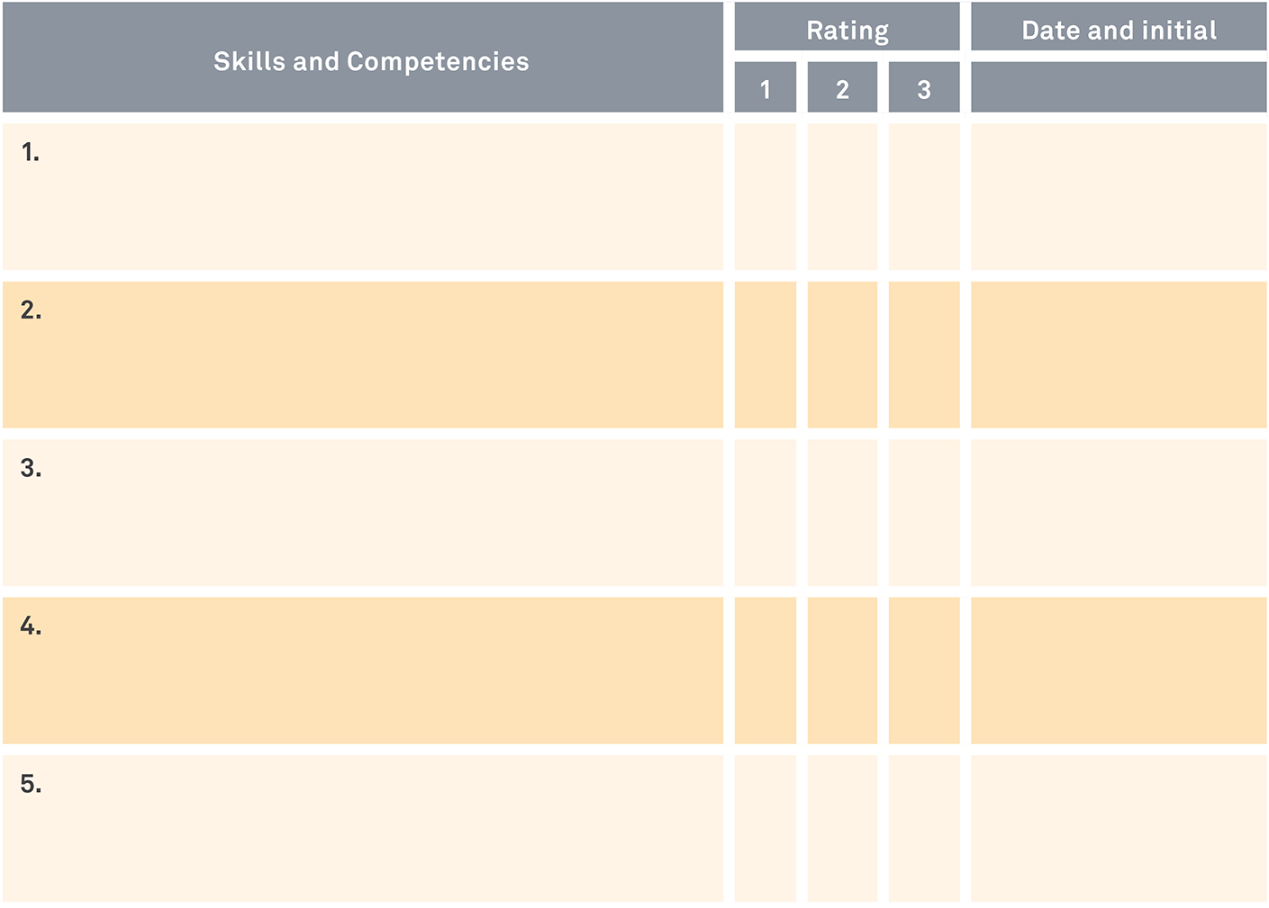
GETTING BEYOND THE TASK LIST: USING RUBRICS
Notes:
Brainstorming EXERCISE: using a rubric to assess on-the-job skills.
NOTE: this rubric is an example, but should be customized based on material provided by companies. Faculty trainers should develop this basic rubric with real-life examples and walk supervisor/mentor trainees through it in small groups. See tools section.

Slide 45
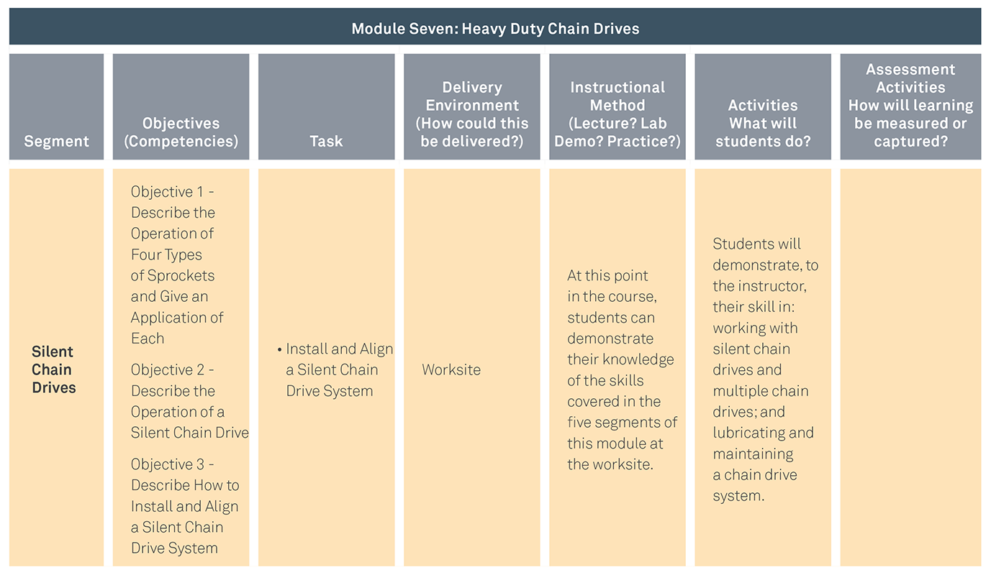
GETTING BEYOND THE TASK LIST: USING RUBRICS EXERCISE
Notes:
Brainstorming exercise
Use materials from the task analysis sample provided on the left to practice brainstorming how to select assessments using the tool on the right.
This exercise is designed to help supervisors think about how they could assess for learning on the job. Have participants work in groups to brainstorm a few ways to assess each listed task (here, “install and align a silent chain drive system” and “install and align a multiple strand chain drive system using a taper lock bushing”) in each category (interim, formative, and summative). Have participants share their ideas.

Slide 46
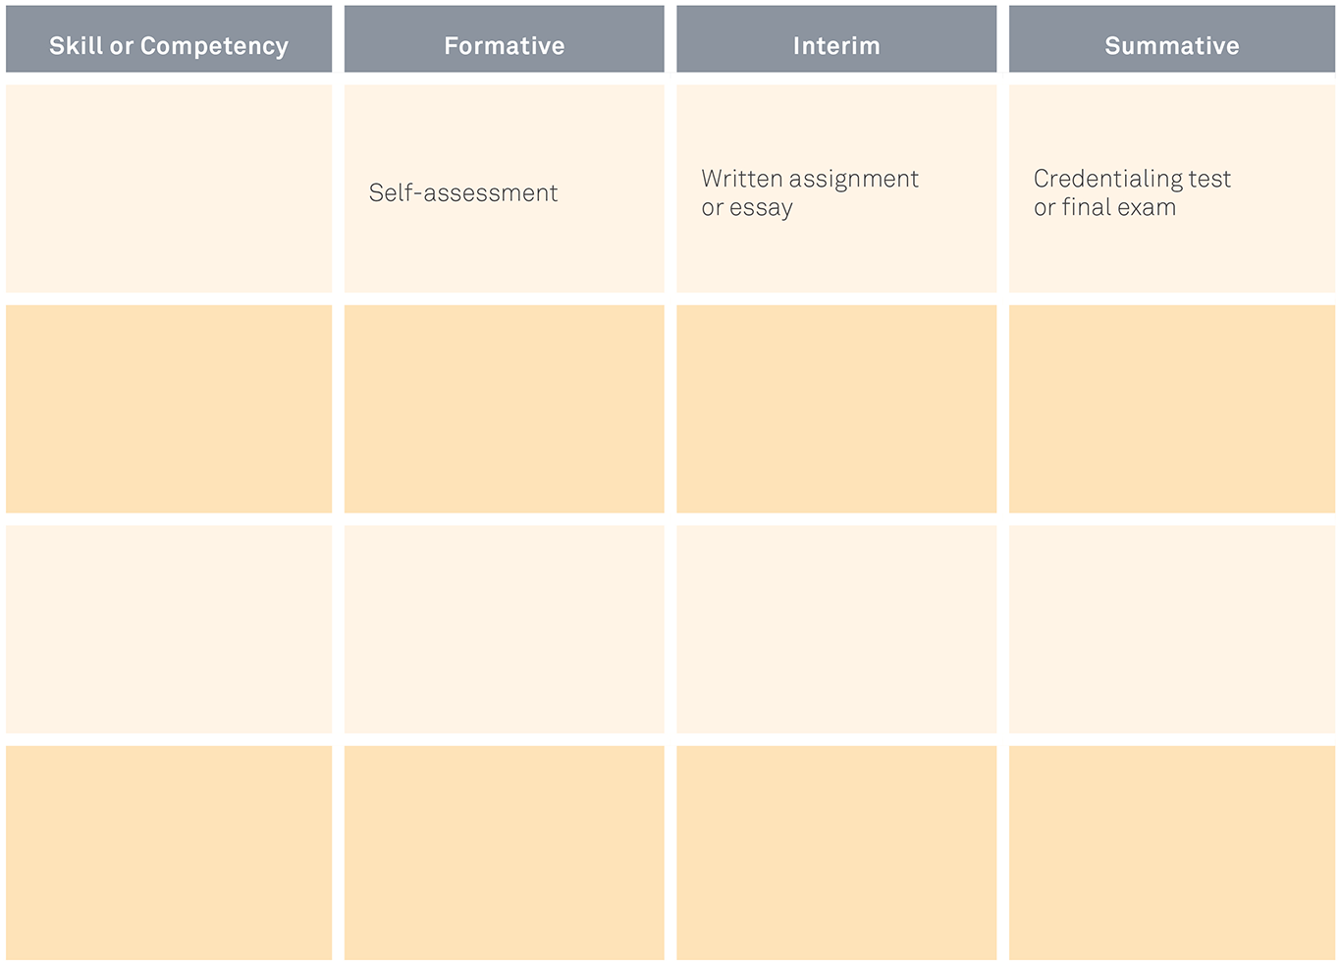
USING RUBRICS EXERCISE (continued)

Slide 47
CREATING AN ASSESSMENT PORTFOLIO
FACULTY CONTRIBUTIONS
Entry exams, standardized tests
Official transcripts and records
Online materials and assessments
EMPLOYER SUPERVISORS CONTRIBUTIONS
Documentation (work logs, task lists)
Employer work records (attendance, performance)
Rubrics and work samples

