Slide 1

ADDING A GENDER LENS TO NONTRADITIONAL JOBS TRAINING
^{APRIL 2017}
CREATED BY WIDER OPPORTUNITIES FOR WOMEN
TOOL 6.4
Providing Equitable Health and Safety Protection to Women: Construction and Trucking
This tool is part of Adding a Gender Lens to Nontraditional Jobs Training, created by Wider Opportunities for Women for the GreenWays initiative and revised by JFF as part of the Delivering the TDL Workforce initiative. All tools are available online at: http://www.jff.org/newlensonjobs.
Supported by the Walmart Foundation, Delivering the TDL Workforce expanded high-quality transportation, distribution, and logistics training programs in ten regions and promoted best practices in program design and delivery, employer engagement, and workforce partnership development. GreenWays was supported by grants from the U.S. Department of Labor through Pathways Out of Poverty and the Green Jobs Innovation Fund.

Slide 2
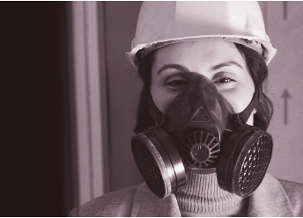
HEALTH AND SAFETY IN CONSTRUCTION: LEARNING OBJECTIVES
STUDENTS WILL BE ABLE TO:
Describe why gender matters in health and safety issues in the construction industry
Describe how health and safety issues are impacted by gender
Describe how issues that are specific to gender can be safety concerns
Demonstrate what individuals can do to protect themselves and their coworkers
Promote equitable health and safety practices and policies in the workplace

Slide 3
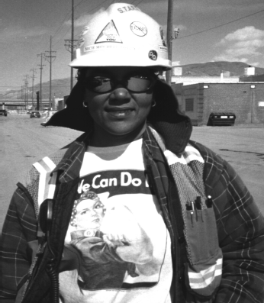
WHY DOES THIS MATTER?
  Gender inequity and gender differences create distinct health and safety issues for women.
  The lack of a “gender lens” on health and safety creates disparate impact.
  Women’s participation in the industry will continue to grow.
  The construction industry needs women.

Slide 4

WHY DOES THIS MATTER?
As a female carpenter said,
“The problem is that there’s a mixture of skills you don't have as a woman, and, at the same time, you’re dealing with hostile men. You could deal with the dangerous work if the men treated you right, or you could handle the men if the work wasn’t so dangerous. It’s the combination that's so hard.”
Source: Chicago Women In Trades (CWIT) 1992

Slide 5
DEPARTMENT OF LABOR REPORT—KEY FINDINGS
“In addition to the primary safety and health hazards faced by all construction workers, there are safety and health issues specific to female construction workers.
The small percentage of females within the construction trades and the serious health and safety problems unique to female construction workers have a circular effect.
Safety and health problems in construction create barriers to women entering and remaining in this field.
In turn, the small numbers of women workers on construction worksites foster an environment in which these safety and health problems arise or continue.”
Source: Report of the DOL OSHA Advisory Committee on Construction Safety and Health 1999

Slide 6
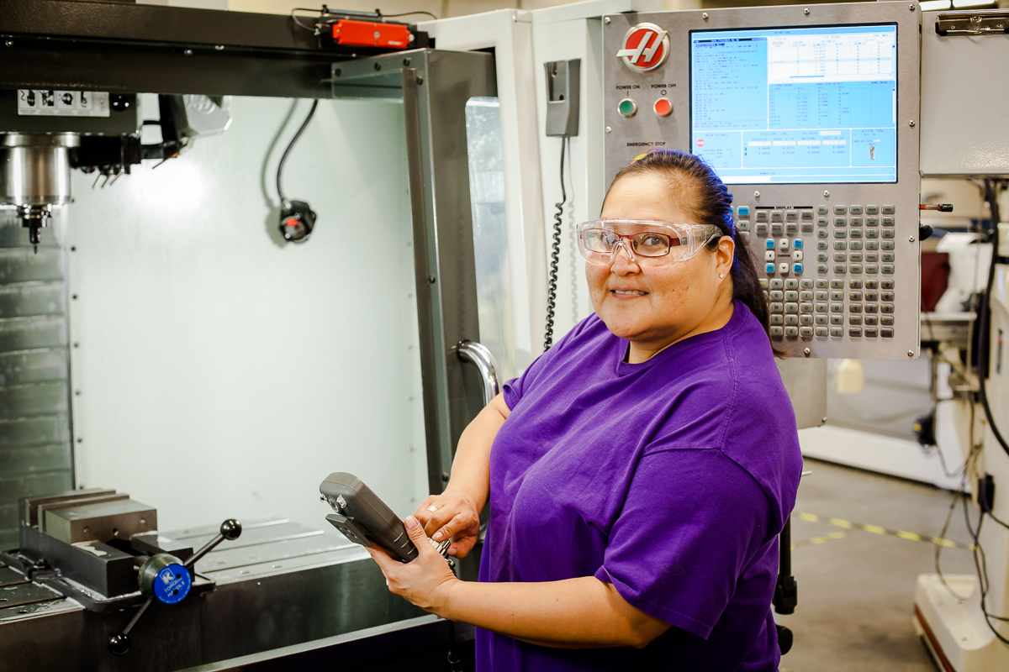
KEY HEALTH AND SAFETY OF WOMEN IN CONSTRUCTION
(HASWIC) ISSUES
Sanitary facilities
Personal Protective Equipment
Ergonomics
Workplace culture
Reproductive hazards
Health and safety training
Injury and illness data and research

Slide 7
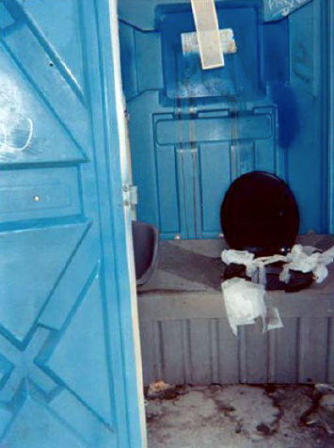
SANITARY FACILITIES
Lack of access
Lack of privacy
Lack of hygienic conditions
Leads to urinary tract infections, heat stroke
In CWIT’s report, 80% of tradeswomen have
encountered worksites with dirty toilets or no toilets.
35% of the women in the second National
Institute of Occupational Safety and Health
(NIOSH) survey answered “false” to the statement,
”There are clean toilets at most jobsites.”

Slide 8
SANITARY FACILITIES
One woman explained that, if a new employee complained about the lack of adequate restroom facilities for women, “You’d see yourself bye-bye.”
“When I complained that there was no toilet they transferred me to another jobsite. They took me
away from a really good partner and good overtime.”
Source: CWIT study 1992
Needing to leave the jobsite for a sanitary facility can take longer than the allowed break time and can lead to disciplinary action.

Slide 9
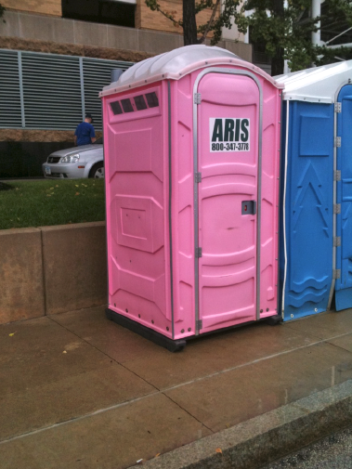
SANITATION IS POSSIBLE—AND THE LAW
TOILETS AT CONSTRUCTION JOBSITES
California State Law 1526(a)
A minimum of one separate toilet facility shall be provided for each 20 employees or fraction thereof of each sex. Such facilities may include both toilets and urinals provided that the number of toilets shall not be less than one half of the minimum required number of facilities.
(b) Under temporary field conditions, not less than one toilet shall be available.
(d) Toilet facilities shall be kept clean, maintained in good working order, designed and maintained in a manner which will assure privacy and provided with an adequate supply of toilet paper.

Slide 10
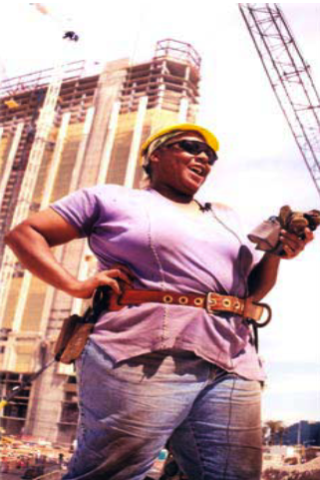
PERSONAL PROTECTIVE EQUIPMENT (PPE)
Not properly designed to fit women’s body sizes
“One size fits all” means all men, women’s sizes are not just small men’s sizes
Poor fit may mean no fit and
unworn PPE
Poor fit compromises protection, productivity and long term health
Bad fit is a safety hazard

Slide 11
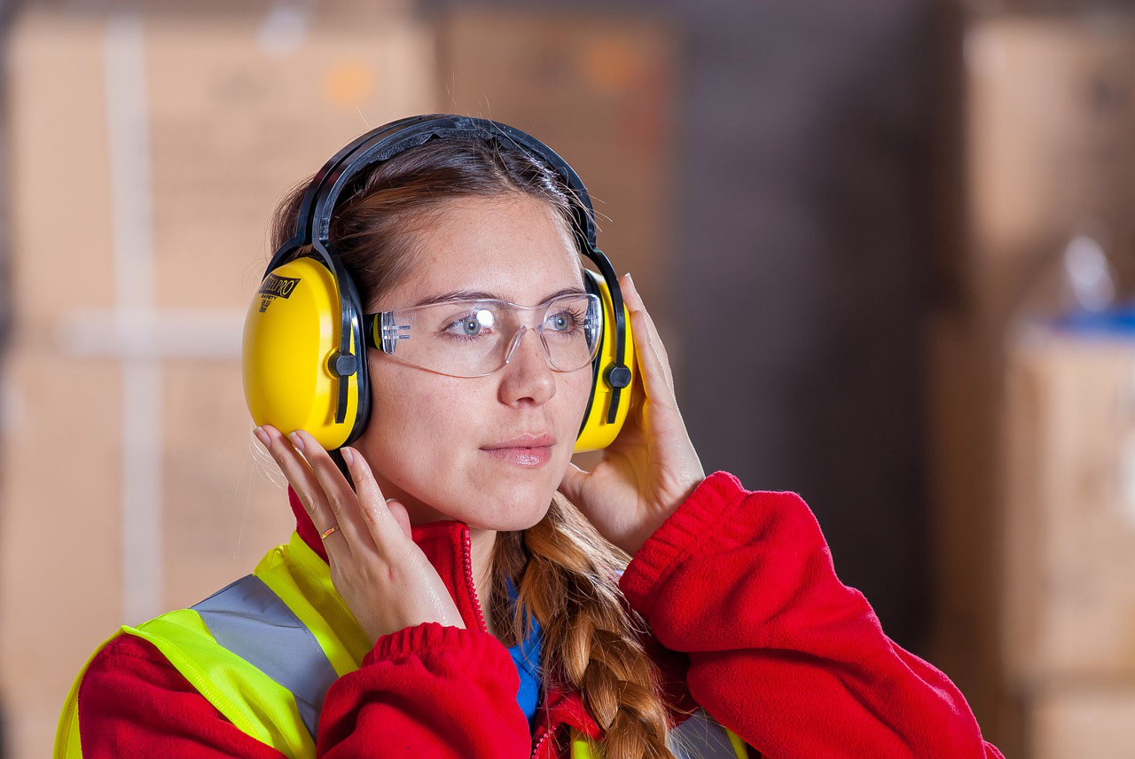
PERSONAL PROTECTIVE EQUIPMENT
IMPROPERLY-FITTING EQUIPMENT CAN MEAN:
Compromised protection—more risk of exposure
Difficulty in doing certain tasks (e.g., jobs requiring fine, detailed movements)
Working less efficiently: oversized gloves may cause a worker to grasp a tool tighter than she should in order to get a good grip
Slower work (muscular fatigue and frequent readjustments of gloves can slow a worker down)
Greater number of errors
Additional safety risk

Slide 12
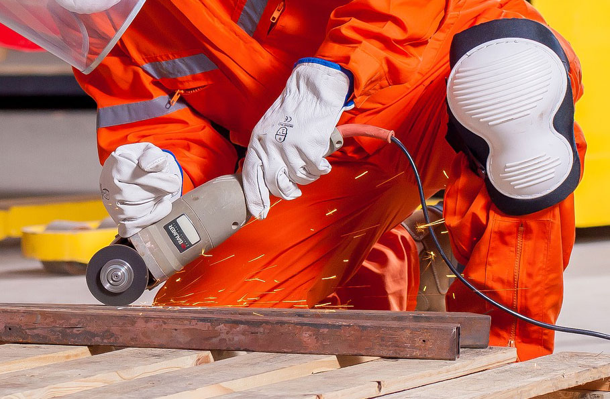
PERSONAL PROTECTIVE EQUIPMENT
Studies by NIOSH and the U.S. Department of the Army found that most tools, equipment, and clothing are not designed for a women’s physique.
One survey of manufacturers of protective equipment found that only 14% offered ear, head, and face protection in women’s sizes.
59% of the manufacturers surveyed reported offering foot protection in women’s sizes.
When asked if they could easily find protective clothing to fit, 46% of women in the second NIOSH said “no” with respect to work shoes and 41% with
respect to finding work gloves.

Slide 13
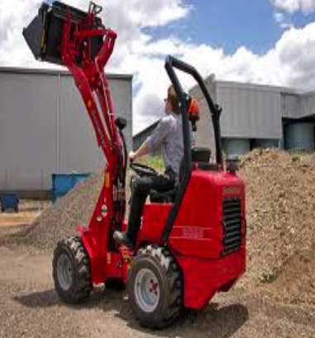
ERGONOMICS
Ergonomics describes finding the “best fit” between the worker and the job conditions
Goal = worker safety, comfort, and productivity
Ergonomic studies assess the interaction of physical abilities and limitations in relation to:
Work tasks
Tools, equipment, and materials
The job environment
Ergonomic studies in construction generally evaluated only male workers.
Ergonomic hazards are the most frequently occurring health hazards in construction
and the cause of most injuries.

Slide 14
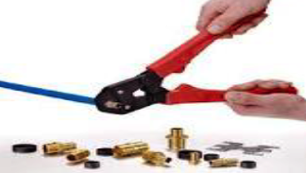
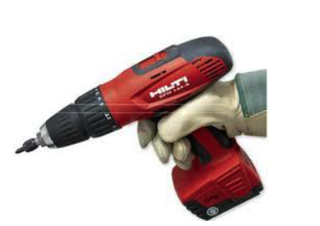
ERGONOMIC HAZARDS: A GENDERED VIEW
GENDER DIFFERENCES:
Female body size and build require distinct techniques for lifting and handling materials and tools
The grips of tools are typically too thick. Tools like pliers require a wide grasp which puts inappropriate pressure on the palm, leading to the loss of functional efficiency
LEADS TO:
Heavy, frequent, or awkward lifting
Using excessive force, overexertion
Using wrong tools for the job or using tools improperly
Awkward grips, postures

Slide 15
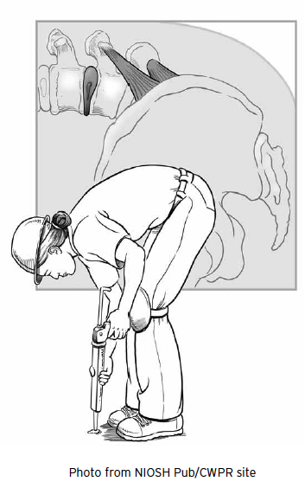
ERGONOMIC HAZARDS: A GENDERED VIEW
Tool and equipment size designed for male physique Handle size and tool weight: average hand length of women is 0.8 inches shorter than the average man’s.
Their grip strength averages two-thirds the power of a man’s grip.
Female body size and build require distinct techniques for lifting and handling.
There is a critical need to increase our knowledge of the “safe limits” for women for lifting and other motions, such as forward flexion of the trunk (bending over).
Source: Ergonom

Slide 16
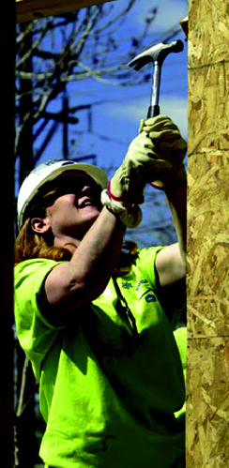
HEALTH AND SAFETY—CONSIDERATIONS FROM BIOLOGICAL
GENDER DIFFERENCES
Menstrual cycles influence women’s bodies
Ligaments more stretchy the week prior to period
Ligaments get more stiff at the onset of the period
Water retention may contribute to carpal tunnel symptoms
Knee joint angle (Q angle) greater due to broader hips
13° males, 18° females
Knee under slightly more stress
Stature
Tools and work stations may not be designed for our frames
Source: Ergonomics for Women in the Trades, Jennifer Hess, DC, MPH University of Oregon, LERC

Slide 17
MALE-DOMINATED WORKPLACE CULTURE
Concern with “fitting in” macho culture may preclude women from using PPE
Women may receive less training to do the job correctly due to protectiveness, isolation or hostility
Lack of job security, or desire for inclusion in male camaraderie limits hazard reporting or requesting safety equipment or practices
“Women in the construction trade...can‘t go out there whining...or we can’t go out there and complain. We just have to bite our lip and deal with it if we want to keep our job and if we want to get along with fellow workers.”

Slide 18
MALE-DOMINATED WORKPLACE CULTURE
Isolation—working as the only female on a jobsite or being ostracized by coworkers:
Can lead to lack of training, support for handling unsafe conditions and stress
Can lead to accidents, unsafe actions
Can lead to sexual harassment, assault or placing someone in harm’s way
“When you have more than one woman working with you, you have a better chance. You don’t want to be alone. The stress is incredible. I had too many illnesses because of that. The more women there are, the more the climate begins
to change.”
52% of the survey respondents in the CWIT study reported that men refused to work with them during their construction careers 22% of respondents to the CWIT survey had never worked with another woman.

Slide 19
SEXUAL HARASSMENT—A SAFETY AND HEALTH CONCERN
In various studies by NIOSH and CWIT, tradeswomen reported the following experiences with sexual harassment:
88% had been confronted with pictures of naked or partially dressed women
83% experienced unwelcome sexual remarks
57% reported being touched or asked for sex
43% had, at some point in their career, experienced uninvited sexually suggestive looks, comments, joking, or gestures from their supervisors
72% reported uninvited sexually suggestive looks, comments, joking, or gestures from co-workers
Sexual harassment
leads to:
Stress
Distraction
Assault
Inability to concentrate
Fear
Lack of trust and collaboration

Slide 20
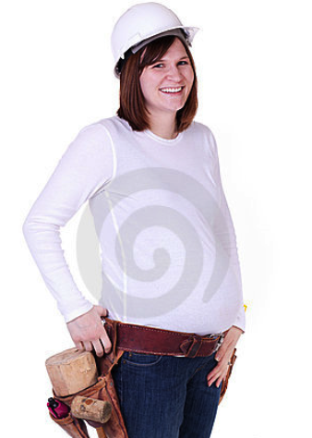
REPRODUCTIVE HAZARDS
Physical concerns
Biological and chemical exposures
Limited research on affect of hazards on
women and men
Studies have shown that male reproductive organs can be as affected as female

Slide 21
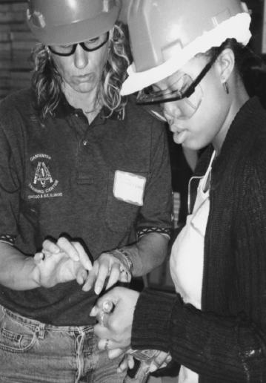
HEALTH AND SAFETY TRAINING
Limited skill training or menial assignments can impede safe working practices
Culture of workplace (macho/production demand) disdains/discourages attention to safety and Health & Safety training
“Many men don’t want to go to safety meetings. I don’t know if it’s a machismo thing or what. They're getting paid. But then there’s always the contractor or boss breathing down your neck, saying, ‘How come this [work] wasn’t done?’ The boss doesn’t say, ‘You’d better go to that safety meeting because I don't want my workers’ comp bill going up this year.”

Slide 22
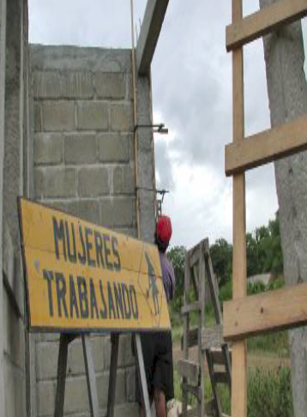
SAFER & HEALTHIER WORK FOR ALL
Share information on where to find gender specific PPE and ergonomically designed tools
Request a gender specific sanitary facility
Encourage coworkers to request clean sanitary facilities and hand-washing on site
Ask for modification to equipment to improve ergonomic functioning

Slide 23
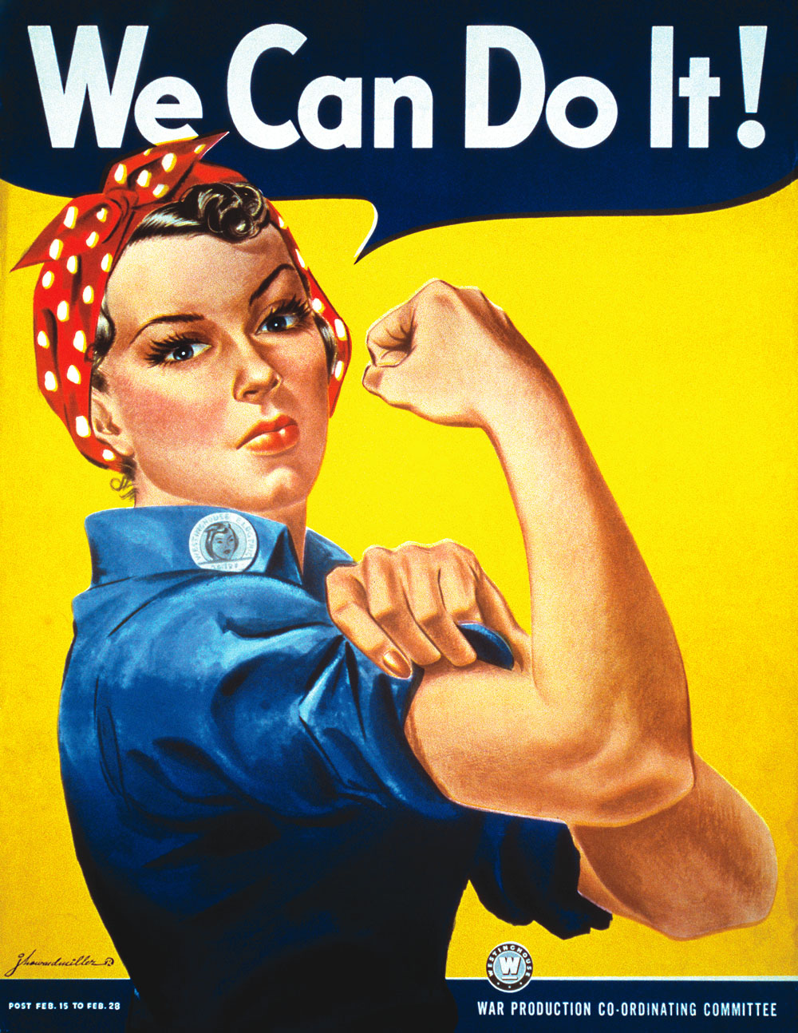
THINGS YOU CAN DO TO IMPROVE WOMEN’S HEALTH AND SAFETY ON THE JOB
Attend and engage in safety and health meetings
Talk with the staff person responsible for health and safety at your employer on the worksite about your needs
Advocate for women’s health and safety on the jobsite
Join the union safety committee
Share the HASWIC report with your union, employer, and apprenticeship coordinator

Slide 24
SAFER & HEALTHIER WORK FOR ALL
Be familiar with OSHA requirements, your company’s health and safety policies
Be proactive in collaborating with employer and union on making the workplace safe and healthy for all workers
Share your research on how to ensure gender-specific health and safety policy and practice
Attend trainings
Share the information in this report to back up your requests tO address the issues discussed in this module
You must take responsibility for your own safety and health, even while expecting your employer, union or apprenticeship program to do their part.

Slide 25
A SAFER, HEALTHIER WORKPLACE FOR ALL
Better sanitary facilities for all
More fit-testing to ensure all workers adequate PPE
More respectful and productive workplace
Better attention to safety
Less adherence to the unsafe practices supported by a “macho” culture
Less fear of reprisal for asking for health and safety practices
More knowledge about chemical and material health hazards.
Everyone benefits when safety and health for women is addressed

Slide 26

HEALTH AND SAFETY IN TRUCK DRIVING: LEARNING OBJECTIVES
STUDENTS WILL BE ABLE TO:
Describe how health and safety issues are impacted by gender within the trucking industry
Key Health & Safety Issues for Women In Trucking
Male-Dominated Workplace
Training Period
Truck Stops
Truck Design
Working With Trucking Firms to Accommodate Female Drivers

Slide 27

WHY DOES THIS MATTER?
“Although the challenges women face
are similar to men’s, our priorities are different. Safety and security are a primary focus, as well as amenities and harassment on the road.
We are working to change that, and to encourage an environment where women can work and feel safe while they earn a comparable salary to that of their male peers. But we still have a long way to go and my hope is that more women will find a career in this industry.”
Ellen Voie, CEO of Women In Trucking
Source: https://obamawhitehouse.archives.gov/blog/2012/07/30/advocating-women-moving-america

Slide 28
MALE-DOMINATED WORKPLACE
Male dominated workplace
Within trucking firms – dispatchers and management are typically male.
On the road, other drivers are predominately male.
Women are typically noticeable minorities at truck stops.
Female long-haul drivers have reported experiencing stress based on perceiving:
Difficulty balancing being on the road and responsibility at home
Few resources to deal with gender related problems and a lack of support from co-workers
Feeling like “outsiders” expected to prove proficiency in a way male drivers weren’t
A lack of safety at truck stop parking lots
Source: Bernard, T., Bouck, L. & Young, W. (Sept. 2000). Female Commercial Drivers in the Transportation Industry. American Society of Safety Engineers Foundation Research Report.

Slide 29
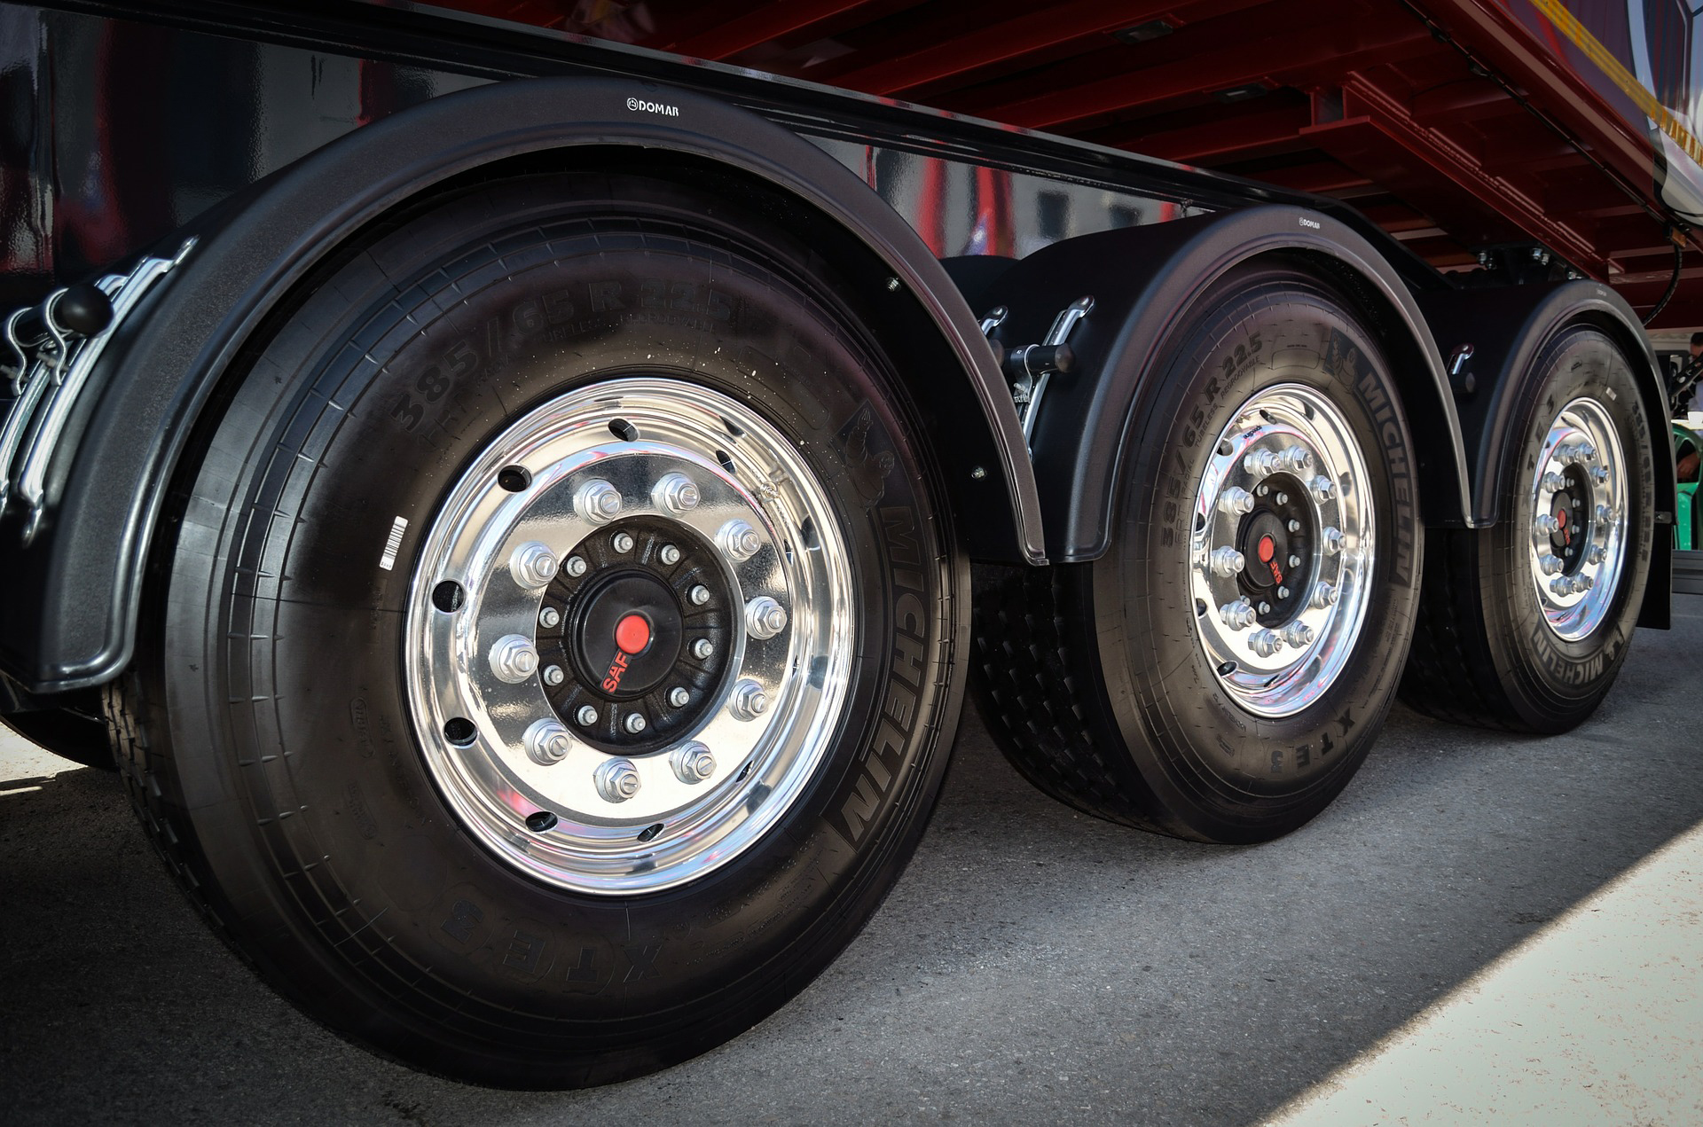
TRAINING PERIOD
Training drivers: evaluate their trainees and validate their readiness
May themselves be inexperienced and not able to
develop good driving in trainee drivers
May seek to leverage their position to exploit
female drivers in training
During training, training drivers and their trainee are largely isolated

Slide 30
TRUCK STOPS
Truck stop safety and amenities vary greatly. Women In Trucking (WIT) created a Truck Stop Directory for drivers to rate stops based on safety, food, showers, parking, and quality.
  http://www.womenintrucking.org/truck-stop-directory

Slide 31
TRUCK STOPS: SAFETY PRECAUTIONS
Park near the front, in a well lit area
Don’t get out of the truck if you don’t have to
Consider carrying a port-a potty so you don’t have leave the truck at night
Take your cell phone and a small amount of cash
Don’t walk between the trucks and take a friend if possible
Walk with purpose (head high, quick steps and don’t get distracted by texting, talking on the phone, etc.)
Consider bringing a pet if your carrier allows as they could bark (even small ones) and will awaken a driver in the event of a predator

Slide 32

TRUCK DESIGN: ERGONOMICS AND SAFETY
Truck cabs are typically designed for taller male bodies
Seatbelt shoulder straps do not fit women’s bodies
Grab handles placed too high
Difficult access to oil and cool and checks and fill ports
Poor placement of armrest
Hood lift/closure too height
Foot pedal at difficult height to reach
Cab security systems may not sufficiently protect a driver in the sleeper berth

Slide 33
ADDITIONAL TRAINING TOPICS
In a 2000 survey of female drivers, respondents reported being satisfied with training on vehicles and equipment as well as regulations, but indicated other training topics would be useful, including:
Stress reduction practices
How to get physical exercise during a trip
Fatigue prevention
Self-defense techniques (particularly due to unsafe rest areas)
Other topics to educate female drivers on include:
Conflict resolution
Hostile work environments
Policies on harassment and how to take action
On-The-Road issues: truck stop amenities and safety, where to park at truck stops, and procedure during breakdowns
Sources: Women In Trucking, Addressing Harassment Issues: A Guide for Employers in the Trucking Industry (full content available to members at www.womenintrucking.org). Bernard, T., Bouck, L. & Young, W. (Sept. 2000). Female Commercial Drivers in the Transportation Industry. American Society of Safety Engineers Foundation Research Report.

Slide 34

This tool is part of Adding a Gender Lens to Nontraditional Jobs Training, created by Wider Opportunities for Women for the GreenWays initiative and revised by JFF as part of the Delivering the TDL Workforce initiative. All tools are available online at: http://www.jff.org/newlensonjobs.
Supported by the Walmart Foundation, Delivering the TDL Workforce expanded high-quality transportation, distribution, and logistics training programs in ten regions and promoted best practices in program design and delivery, employer engagement, and workforce partnership development. GreenWays was supported by grants from the U.S. Department of Labor through Pathways Out of Poverty and the Green Jobs Innovation Fund.
Jobs for the Future (JFF) is a national nonprofit that builds educational and economic opportunity for underserved populations in the United States. JFF develops innovative programs and public policies that increase college readiness and career success and build a more highly skilled, competitive workforce. With over 30 years of experience, JFF is a recognized national leader in bridging education and work to increase economic mobility and strengthen our economy.
WWW.JFF.ORG

