Slide 1

ADDING A GENDER LENS TO NONTRADITIONAL JOBS TRAINING
^{APRIL 2017}
^{CREATED BY WIDER OPPORTUNITIES}
TOOL 4.6 BUILDING CULTURAL COMPETENCY AND RESPECT FOR DIVERSITY
This tool is part of Adding a Gender Lens to Nontraditional Jobs Training, created by Wider Opportunities for Women for the GreenWays initiative and revised by JFF as part of the Delivering the TDL Workforce initiative. All tools are available online at: http://www.jff.org/newlensonjobs.
Supported by the Walmart Foundation, Delivering the TDL Workforce expanded high-quality transportation, distribution, and logistics training programs in ten regions and promoted best practices in program design and delivery, employer engagement, and workforce partnership development. GreenWays was supported by grants from the U.S. Department of Labor through Pathways Out of Poverty and the Green Jobs Innovation Fund.

Slide 2
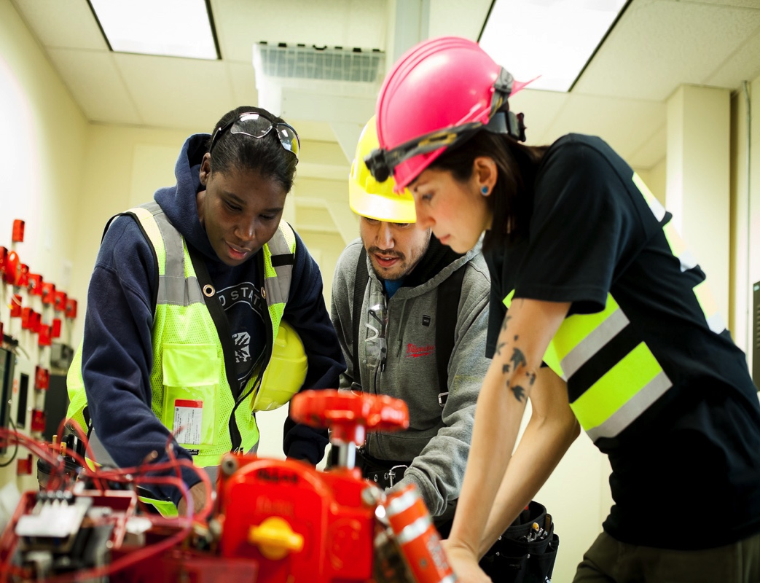
BENEFITS OF WOMEN’S PARTICIPATION IN NONTRADITIONAL INDUSTRIES
  Benefits of Diversity in Workforce
  Expanded Pool of Candidates
  Increased Market Share
  Public Image
  Social Justice
  Equal Employment Opportunity and Affirmative Action Regulations
  Community Benefit Agreements/Project Labor Agreements

Slide 3
GENDER EQUITY QUIZ: QUESTIONS
Gender Equity Quiz:
Test your knowledge!
  Women in female-dominated occupations requiring less than a bachelor’s degree earn how much for $1.00 earned by men in male-dominated occupations requiring less than a bachelor’s degree?
  Women represent what percent of workers in occupations requiring less than a bachelor’s degree that pay less than $30,000 per year? What percent of workers in jobs that pay at least $35,000 per year?
  African-American women today earn, on average, how much for $1.00 earned by white men? How about Latina women?
  The average full-time working women will lose how much in wages over a 40-year period due to the wage gap?
  What percent of women work in occupations that do not require a bachelor’s degree?
  Women in construction earn, on average, how much for $1.00 earned by men?
  What percent of women work in occupations where women make up at least three-quarters of the workforce?
  Women accounted for what percent of apprenticeships in 2016?
  What percentage of people employed in transportation and material moving occupations are women?
  What percentage of people employed in construction occupations are women?

Slide 4
GENDER EQUITY QUIZ: ANSWERS
  Women in female-dominated occupations requiring less than a bachelor’s degree earn how much for $1.00 earned by men in male-dominated occupations requiring less than a bachelor’s degree? $0.66
  Women represent what percent of workers in occupations requiring less than a bachelor’s degree that pay less than $30,000 per year? What percent of workers in jobs that pay at least $35,000 per year? 83%/36%
  African-American women today earn, on average, how much for $1.00 earned by white men? How about Latina women? $0.65/$0.58
  The average full-time working women will lose how much in wages over a 40-year period due to the wage gap? $460,000
  What percent of women work in occupations that do not require a bachelor’s degree? 72%
  Women in construction earn, on average, how much for $1.00 earned by men? $0.95
  What percent of women work in occupations where women make up at least three-quarters of the workforce? 39%
  Women accounted for what percent of apprenticeships in 2016? 6%
  What percentage of people employed in transportation and material moving occupations are women? 18%
  What percentage of people employed in construction occupations are women? 4%
Gender Equity Quiz:
Answers

Slide 5
LIFETIME DIFFERENCE IN EARNINGS
  TRADITIONAL
Nurse Assistant
$12.64 per hour
$25,280 per year
$758,400 in 30 years
  NONTRADITIONAL
Electrician
$25.42 per hour
$50,840 per year
$1,525,200 in 30 years
DIFFERENCE: $1,525,200 - $758,400 = $766,800
5

Slide 6
LIFETIME DIFFERENCE IN EARNINGS
  TRADITIONAL
Receptionist
$12.57 per hour
$25,140 per year
$754,200 in 30 years
  NONTRADITIONAL
Aircraft Mechanic
$28.99 per hour
$57,980 per year
$1,739,400 in 30 years
DIFFERENCE: $1,739,400 - $754,200 = $985,800
6

Slide 7
ROOTS OF INEQUALITY: UNDERSTANDING GENDER (IN)EQUITY
BARRIERS TO WOMEN’S PARTICIPATION
IN NONTRADITIONAL JOBS
  Lack of outreach and information
  Stereotypes and sex segregated vocational education/WIA
  Limited training and disparate impact of selection criteria
  Discriminatory hiring practices
  Differentiated on-the-job training, hiring, job, and overtime assignments
  “Deleterious impact of micro-inequities over time”
Notes:
Roots of Inequality: Understanding Gender (In)Equity and Occupational Segregation

Slide 8
MYTHS AND FACTS
MYTH:
Blue collar work is nontraditional for women.
MYTH:
Women are not strong enough to do heavy labor.
MYTH:
Women won’t like nontraditional jobs.
FACT:
Many jobs now thought to be nontraditional for women have been performed by women in the past
FACT:
The strength requirements for nontraditional jobs are often exaggerated. Many nontraditional jobs are not much more physically demanding than housework, and many traditional women’s jobs, such as nursing and waitressing, are just as physically demanding as some nontraditional jobs.
FACT:
Many women enjoy working with their hands and working outdoors. They take great pride in knowing that they have helped to build or create something. Many women in nontraditional jobs report a high degree of job satisfaction.
Notes:
Throughout history, women have done heavy labor on the farm and in the fields alongside men.
During World War II, over 6 million women entered the labor force to build ships and airplanes and make factory goods.
These jobs are currently considered nontraditional only because women are underrepresented in them.

Slide 9
MYTHS AND FACTS
MYTH:
Women aren’t interested in nontraditional jobs.
MYTH:
Women won’t want to tolerate the working conditions in male-dominated blue collar jobs.
MYTH:
Women’s family responsibilities will interfere with working conditions and hours of nontraditional jobs
  FACT:
Often, women haven’t considered the possibility of nontraditional jobs, but once they are introduced to the opportunities they are often quite interested in exploring more.
  FACT:
  Working conditions in many traditionally female jobs require working in all weather, dirty, noisy, and sometimes dangerous situations.
  FACT:
Most working parents manage work and family responsibilities, and programs can link women to resources to help identify support services for childcare
Notes:
. Throughout history, women have done
heavy labor on the farm and in the fields alongside
men. During World War II, over 6 million women
entered the labor force to build ships and airplanes
and make factory goods. These jobs are currently
considered nontraditional only because women are
underrepresented in them.

Slide 10
MULTICULTURAL DYNAMICS IN THE CLASSROOM
  Check out you own experience and understanding of multiculturalism and diversity.
  When did you first became aware of differences? What was your reaction? Were you the focus of attention or were others? How did that affect how you reacted to the situation?
  What are the “messages” that you learned about various “minorities” or “majorities” when you were a child? At home? In school? Have your views changed considerably since then? Why or why not?
  Recall an experience in which your own difference put you in an uncomfortable position vis-à-vis the people directly around you. What was that difference? How did it affect you?
  Rate your level of comfort when you are the only: male, white person, straight person, young person, of another religion
Adapted from: Teaching for inclusion (1998). Chapel Hill, NC: Center for Teaching and Learning, University of North Carolina at Chapel Hill.
Notes:
When we speak of multicultural dynamics in the classroom, we usually focus on the diversity of the students in the room. We often forget that the teacher also brings a range of diversity issues to the classroom. Every instructor brings his or her physical appearance and culture into the room at the same time as the students do. How you look, how you speak, how you act upon your opinions of the role of academics (and particularly of the class you teach), and the extent to which these differ from the physical, cultural, and intellectual backgrounds of your students will have a profound effect on the interactions in your classroom. Thus, you need to be aware of possible reactions among the students to your race, gender, age, ethnicity, physical attributes, and abilities. Preparing for such reactions will involve not only knowing as much as you can about your students, but also turning the mirror to yourself, and finding out more about your own diversity issues.
You might identify your own attitudes toward diversity by remembering certain pivotal moments in your life. Ask yourself the following questions:
Recall the incident in which you first became aware of differences. What was your reaction? Were you the focus of attention or were others? How did that affect how you reacted to the situation?
What are the “messages” that you learned about various “minorities” or “majorities” when you were a child? At home? In school? Have your views changed considerably since then? Why or why not?
Recall an experience in which your own difference put you in an uncomfortable position vis-à-vis the people directly around you. What was that difference? How did it affect you?
How do your memories of differences affect you today? How do they (or might they) affect your teaching?
Teachers should be aware of the comfort level they have in discussing these topics before they enter a classroom. It is crucial to understand how you feel about these issues and what you would say in a room where some may not understand your particular position. If diversity becomes a topic of discussion in the class, students will expect the teacher to be able to explain her or his perspective. Try to have thought of a formulation that clarifies your perspective, while leaving enough room for your students’ perspectives in the discussion. You may look like you “belong to” a minority, or to a majority, even if you do not. Either way, your students will initially perceive this to the exclusion of your own diverse experiences, intentions, background, etc. until they get to know you better.
Reprinted with permission from: Teaching for inclusion (1998). Chapel Hill, NC: Center for Teaching and Learning, University of North Carolina at Chapel Hill.
When we speak of multicultural dynamics in the classroom, we usually focus on the diversity of the students in the room. We often forget that the teacher also brings a range of diversity issues to the classroom. Every instructor brings his or her physical appearance and culture into the room at the same time as the students do. How you look, how you speak, how you act upon your opinions of the role of academics (and particularly of the class you teach), and the extent to which these differ from the physical, cultural, and intellectual backgrounds of your students will have a profound effect on the interactions in your classroom. Thus, you need to be aware of possible reactions among the students to your race, gender, age, ethnicity, physical attributes, and abilities. Preparing for such reactions will involve not only knowing as much as you can about your students, but also turning the mirror to yourself, and finding out more about your own diversity issues.
You might identify your own attitudes toward diversity by remembering certain pivotal moments in your life. Ask yourself the following questions:
Recall the incident in which you first became aware of differences. What was your reaction? Were you the focus of attention or were others? How did that affect how you reacted to the situation?
What are the “messages” that you learned about various “minorities” or “majorities” when you were a child? At home? In school? Have your views changed considerably since then? Why or why not?
Recall an experience in which your own difference put you in an uncomfortable position vis-à-vis the people directly around you. What was that difference? How did it affect you?
How do your memories of differences affect you today? How do they (or might they) affect your teaching?
Teachers should be aware of the comfort level they have in discussing these topics before they enter a classroom. It is crucial to understand how you feel about these issues and what you would say in a room where some may not understand your particular position. If diversity becomes a topic of discussion in the class, students will expect the teacher to be able to explain her or his perspective. Try to have thought of a formulation that clarifies your perspective, while leaving enough room for your students’ perspectives in the discussion. You may look like you “belong to” a minority, or to a majority, even if you do not. Either way, your students will initially perceive this to the exclusion of your own diverse experiences, intentions, background, etc. until they get to know you better.
Reprinted with permission from: Teaching for inclusion (1998). Chapel Hill, NC: Center for Teaching and Learning, University of North Carolina at Chapel Hill.

Slide 11
IMAGES AND WORDS ARE POWERFUL
Cleaning Lady
Clergyman
Congressman
Craftsman
Fireman
Foreman Supervisor/Manager
Businessman
Middleman
Man Hours
Manpower
Manning
Salesman
Stewardess
Weatherman
Workmen’s Compensation

Slide 12
IMAGES AND WORDS ARE POWERFUL
Business Manager/Executive
Housekeeper/Custodian
Clergy
Congressperson/Congressional Representative
Skilled Worker/Artisan
Firefighter
Supervisor/Manager
Liaison/Intermediary
Working Hours
Staffing
Labor Force/Human Resources/Workers
Sales Agent/Associate
Flight Attendant
Weather Forecaster/Meteorologist
Worker’s Compensation

Slide 13

This tool is part of Adding a Gender Lens to Nontraditional Jobs Training, created by Wider Opportunities for Women for the GreenWays initiative and revised by JFF as part of the Delivering the TDL Workforce initiative. All tools are available online at: http://www.jff.org/newlensonjobs.
Supported by the Walmart Foundation, Delivering the TDL Workforce expanded high-quality transportation, distribution, and logistics training programs in ten regions and promoted best practices in program design and delivery, employer engagement, and workforce partnership development. GreenWays was supported by grants from the U.S. Department of Labor through Pathways Out of Poverty and the Green Jobs Innovation Fund.
Jobs for the Future (JFF) is a national nonprofit that builds educational and economic opportunity for underserved populations in the United States. JFF develops innovative programs and public policies that increase college readiness and career success and build a more highly skilled, competitive workforce. With over 30 years of experience, JFF is a recognized national leader in bridging education and work to increase economic mobility and strengthen our economy.
WWW.JFF.ORG

