Slide 1

ADDING A GENDER LENS TO NONTRADITIONAL JOBS TRAINING
^{APRIL 2017}
CREATED BY WIDER OPPORTUNITIES FOR WOMEN
TOOL 4.1
PUTTING A GENDER LENS ON TRAINING AND CURRICULA AND TEACHING: OVERVIEW PRESENTATION
This tool is part of Adding a Gender Lens to Nontraditional Jobs Training, created by Wider Opportunities for Women for the GreenWays initiative and revised by JFF as part of the Delivering the TDL Workforce initiative. All tools are available online at: http://www.jff.org/newlensonjobs.
Supported by the Walmart Foundation, Delivering the TDL Workforce expanded high-quality transportation, distribution, and logistics training programs in ten regions and promoted best practices in program design and delivery, employer engagement, and workforce partnership development. GreenWays was supported by grants from the U.S. Department of Labor through Pathways Out of Poverty and the Green Jobs Innovation Fund.

Slide 2
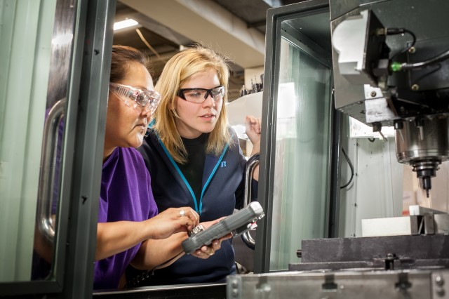
INTRODUCTION
This presentation introduces strategies for developing and delivering job training that targets women enables them to compete better in securing apprenticeships and employment in the building trades and other nontraditional fields.
The presentation addresses why a curriculum focused on women and other underrepresented populations is necessary and how to ensure gender inclusivity, sensitivity, and neutrality in teaching methods and program design.
For a broader perspective on including a gender lens in aspects of program design beyond the classroom, combine this overview with:
Tool 1.2: Recruiting Women into Nontraditional Jobs and Industries
Tool 2.1: Assessment and Case Management Strategies to Support Women’s Participation and Success in Nontraditional
Jobs
Tool 4.2: Checklist and Work Plan for Putting a Gender Lens on Training Design
Tool 4.4: Worksheet for Understanding Privilege
WHO SHOULD USE THIS TOOL
Instructors and trainers
ACKNOWLEDGEMENTS: This presentation is adapted from a 2011
presentation to the Building and Construction Trades Department,
AFL-CIO, as part of the GreenWays initiative, funded by a
U.S. Department of Labor Pathways Out of Poverty grant

Slide 3

AGENDA
ACKNOWLEDGING GENDER IN THE DESIGN
AND DELIVERY OF CURRICULA
INTRODUCING CULTURAL COMPETENCY
STRATEGIES FOR ADDING A GENDER LENS
TO A CURRICULUM
  Elements of Effective Education for Women
  Teaching Inclusively
BEYOND CLASSROOM INSTRUCTION
QUESTIONS AND DISCUSSION

Slide 4
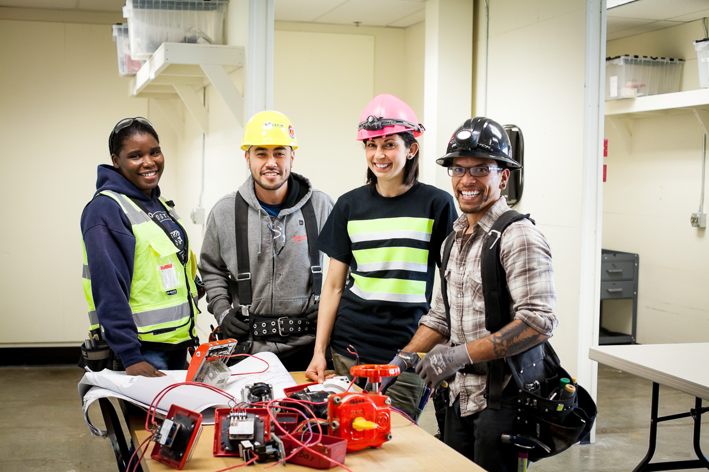

TODAY’S LEARNING OBJECTIVES
Develop skills and resources to address differences in working with traditionally underrepresented populations
Understand policies and practices that promote neutrality, sensitivity, and inclusivity around gender in the content and delivery of a curriculum
Learn how to use a gender lens when delivering curriculum modules

Slide 5
ACKNOWLEDGING GENDER IN THE DESIGN
AND DELIVERY OF A CURRICULUM
WHAT IS YOUR CURRENT CAPACITY?
Examples of underrepresented groups are
evident in training materials and throughout
the training facility.
Our staff members have a deep understanding
of the impact of gender stereotypes and hidden
biases, and they understand the need for gender
and culturally sensitive teaching practices.
We have professional development that builds the capacity of the staff to serve traditionally underrepresented groups.
We emphasize women‘s role in the history
of and in the current field
EXERCISE
For each statement, raise your hand in groups according to:
1) We agree
2) Needs work
3) Never considered

Slide 6
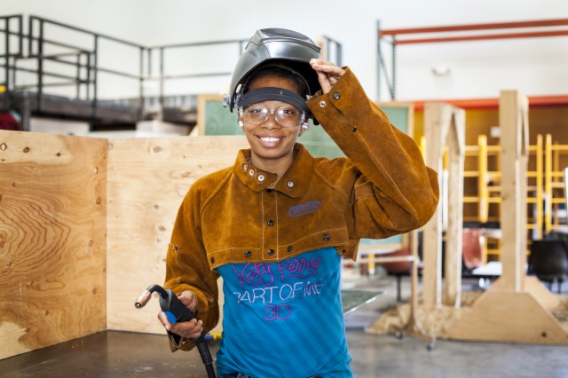
ACTIVITIES TO BUILD A DIVERSE, MULTICULTURAL, AND QUALIFIED WORKFORCE
Evaluate your program’s policies and practices
with regard to cultural competency.
Go out of your way to recruit and serve women.
Provide case management strategies that support women, from assessment through job retention.
Ensure that your job-readiness training is designed to prepare all participants.
Advocate for diversity and equity with industry stakeholders.
Apply a gender lens as you design and deliver your curriculum.

Slide 7
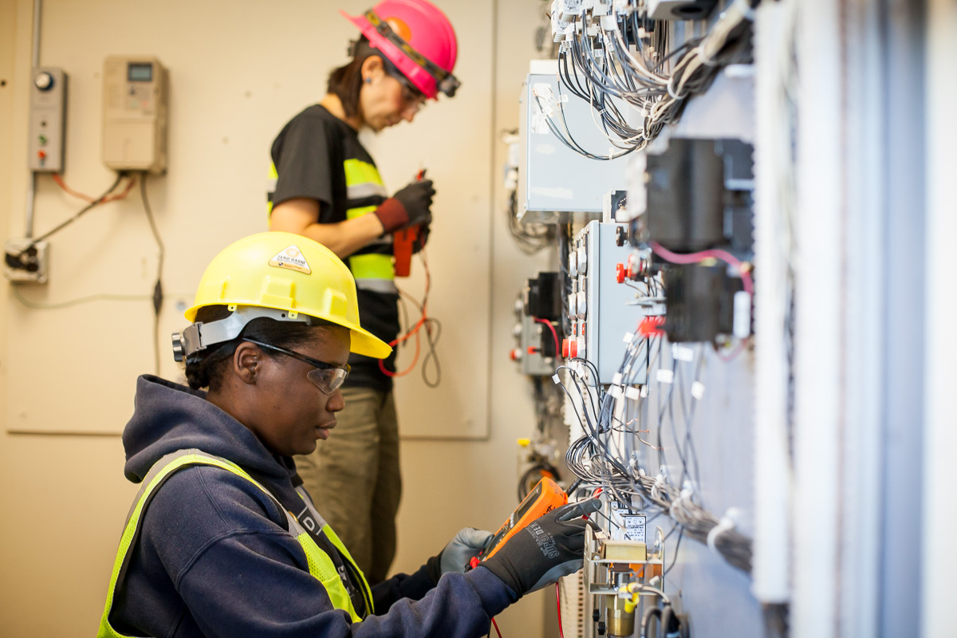
INTRODUCING CULTURAL COMPETENCY
Cultural competence refers to an ability to interact effectively with people of different cultures and socio-economic backgrounds.
Cultural competence comprises four components:
Awareness of one's own cultural worldview
Attitude towards cultural differences
Knowledge of different cultural practices and worldviews
Cross-cultural skills.
Developing cultural competence results in an ability to understand, communicate with, and effectively interact with people across cultures.
Adapted from: “The Cultural Competence: The Nuts and Bolds of Strategic Diversity & Inclusion,” by Mercedes Martin & Billy Vaughn, http://diversityofficermagazine.com/cultural-competence/cultural-competence-the-nuts-bolts-of-diversity-inclusion.

Slide 8
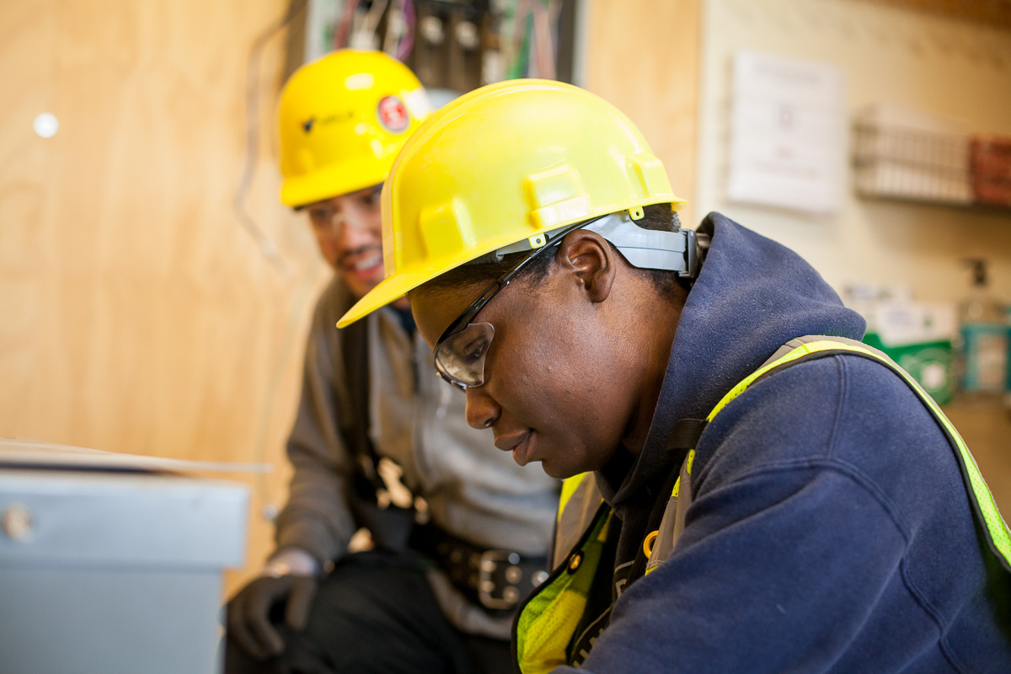
I HAVE THE PRIVILEGE OF BEING UNAWARE OF MY PRIVILEGE.
To understand the cultural barriers that others face, examine the advantages you enjoy.
Reflect on any privileges you may have.
Ask yourself:
Do we live in a world where merit alone determines who gets ahead?
What unearned opportunities are common in our society?
How does your “legacy” appear in your daily life? This includes not only any financial benefits from your family but also such things as your gender and race, family members who have gone to college, friends who can help you get jobs, and much more.

Slide 9
HOW DO YOU EXPERIENCE PRIVILEGE?
EXAMPLES OF COMMON PRIVILEGES
I am confident that my co-workers do not think I got my job because of my sex or race.
I am never asked to speak for everyone of my religion.
I am never asked when I discovered I was heterosexual.
If I am married or if I get married, no one expects me to change my name or asks me why I don’t change my name.
When I go to the supermarket, I can find the staple foods that fit with my cultural traditions.
EXERCISE
Name one privilege that you experience because of your gender, race, language, or sexual orientation.
Share another based on your experience in or knowledge of the your industry.

Slide 10
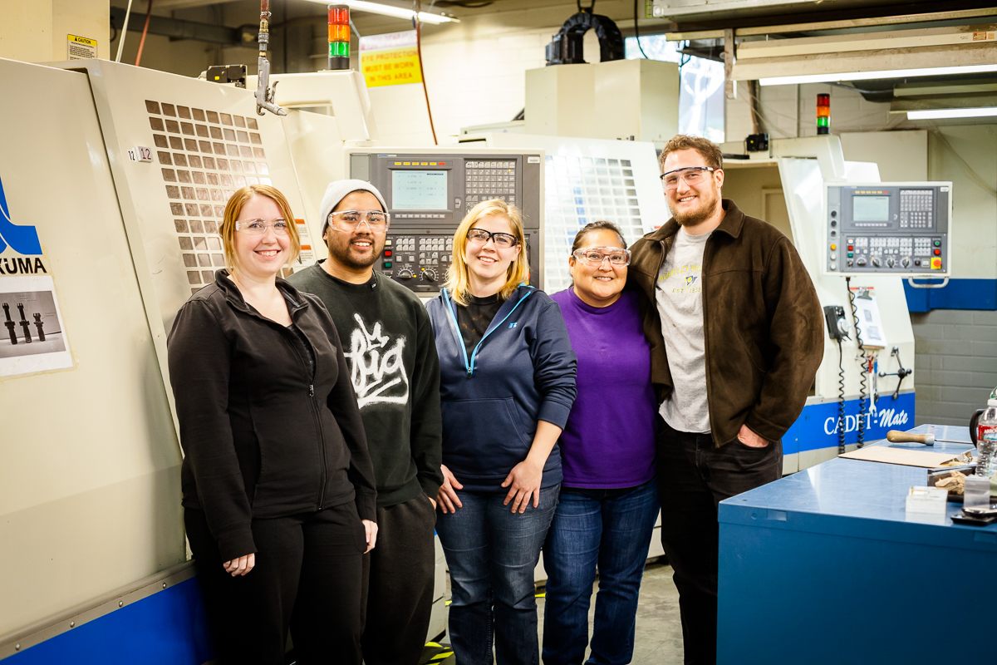
PROGRAM STRATEGIES FOR ADDING A GENDER LENS TO CURRICULUM
ELEMENTS OF EFFECTIVE EDUCATION FOR WOMEN: LEARNING STYLES
What’s different about preparing women for careers in nontraditional occupations such as CNC operators or database analysts?
Women tend to prefer learning experiences that:
They help design
Are learner centered
Engage students in groups
Structure opportunities for feedback on drafts
before a final product
Focus on process
Deemphasize competition
Women are more likely than men to be affected by a lack of confidence, low self-esteem, and being stereotyped.

Slide 11
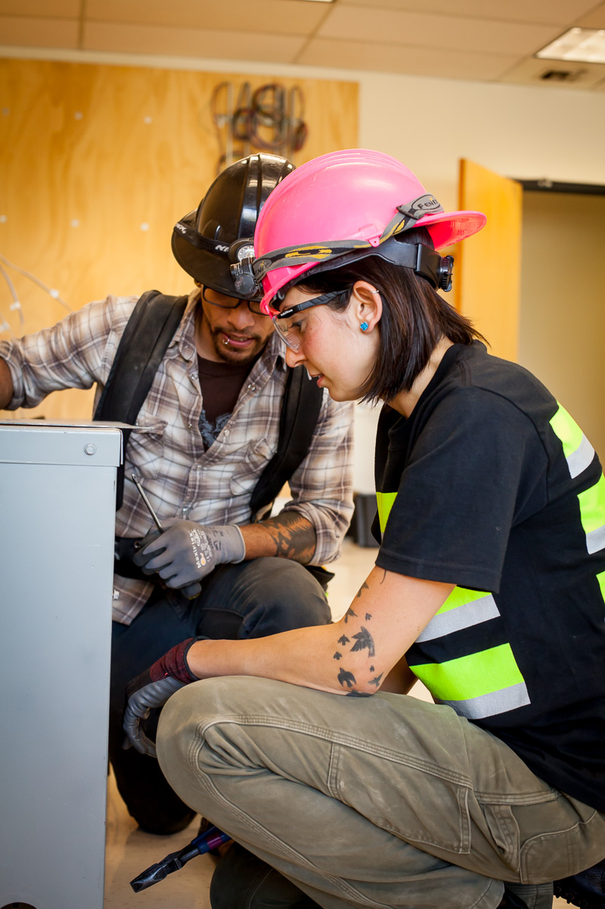
ELEMENTS OF EFFECTIVE EDUCATION FOR WOMEN: COMMUNICATION STYLES
As students, women tend to:
Speak more quietly and briefly than men
Present statements more hesitantly, indirectly, or “politely”
Use “I” statements (“I guess . . .”; “I was wondering if . . .”)
Qualify or apologize for statements (“sort of”; “I may be wrong, but . . .”)
Add “tag” questions (“Isn’t it?” “Don’t you think?”)
Ask questions rather than make statements
Accompany statements with smiles or averted eyes rather than pointing or making other assertive gestures
Students exhibiting these traits may be perceived to be:
Less rigorous in their ability to think critically
Lacking in intellectual sophistication

Slide 12
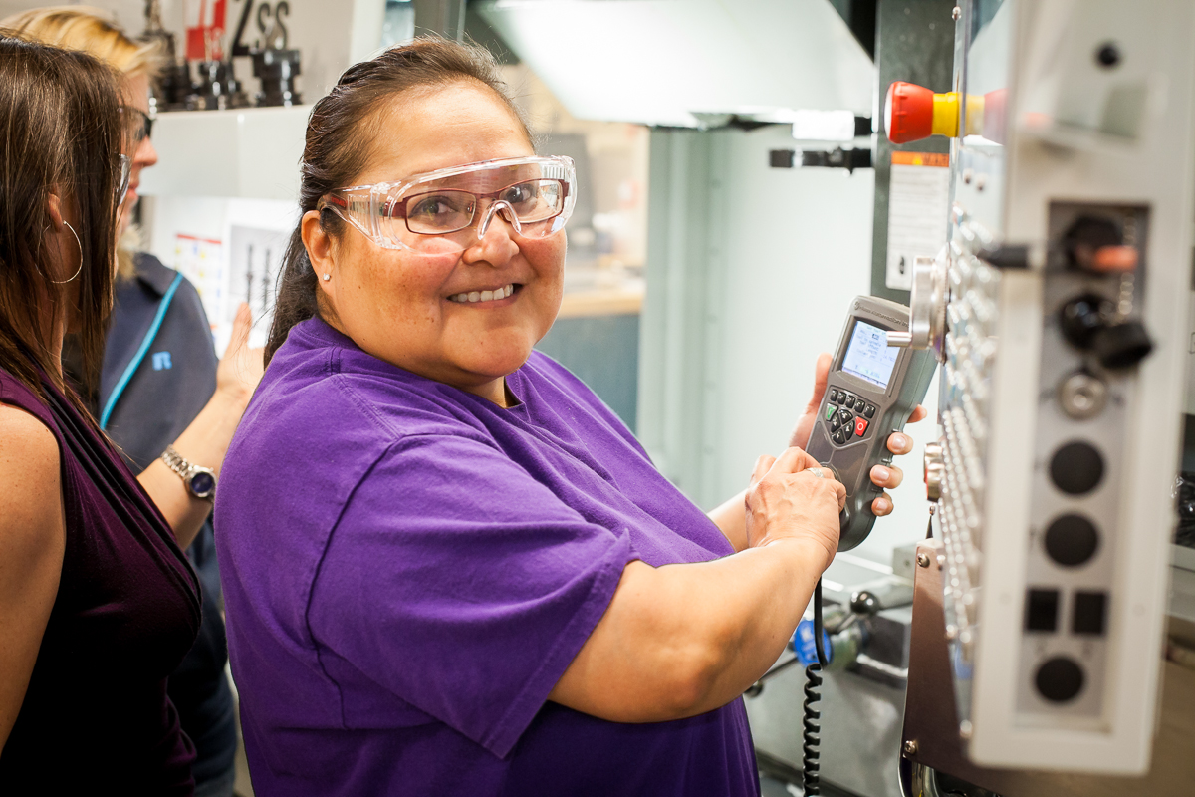
ASSUMPTIONS
As students, women and others from underrepresented groups have highlighted common experiences for them in the classroom:
Teachers have low expectations.
Teachers expect them to speak up about racist or sexist behavior, and they believe that behavior is okay if the students don’t protest
Women and others from underrepresented groups remind instructors not to assume that:
We are all alike
We can speak for our gender, race, or culture
We fit a stereotype or will defend one
Our previous knowledge is not credible
Don’t assume!

Slide 13

TEACHING INCLUSIVELY: CLASSROOM TIPS FOR INSTRUCTORS.
Provide equal attention, instruction, feedback, and praise to students of both sexes.
Don’t overlook quiet but capable students.
Create opportunities for male and female students to work together, and lead, in small groups.
Don’t ask students of one gender to perform activities you wouldn’t ask of the other gender.
Monitor classroom dynamics to avoid stereotyping and subtle classroom inequities.
Use a variety of models for creating or delivering lessons.
Increase the amount of time allotted for students to formulate answers to classroom questions.
Be consistent in your expectations around grading, dress, discipline, behavior, and classroom duties.
Adapted from: Teaching a Diverse Student Body, by Nancy Loevinger, 1994, University of Virginia

Slide 14
AS A TEACHER, YOU BRING YOUR OWN EXPERIENCE AND UNDERSTANDING OF MULTICULTURALISM AND DIVERSITY INTO THE CLASSROOM.
EXERCISE
Discuss one of these topics in a small group.
What messages did you learn about various “minorities” or “majorities” at home when you were a child? In school?
How have your views changed and how have they remained the same since then?
Recall an experience in which your own difference made you feel uncomfortable.
What was that difference? How did it affect you?
Rate your level of comfort when you are the only person in your room of your:
Gender, race or ethnicity, age, religion
Adapted from: Teaching for inclusion, published by the Center for Teaching and Learning, University of North Carolina at Chapel Hill, 1997

Slide 15
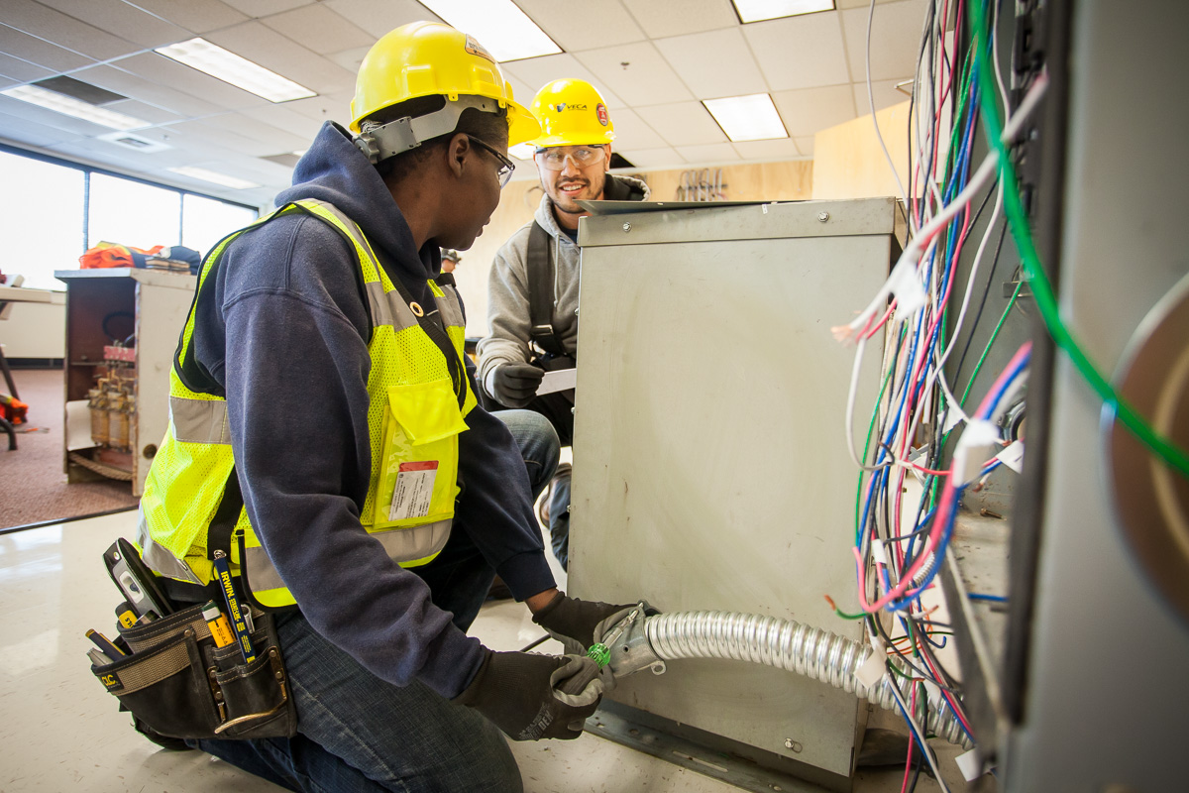
CHOICE OF IMAGES AND WORDS
Images and words convey a lot about
how we feel.
Avoid sexist and racist language in classroom discussions and written materials distributed to the class.
Highlight images of women and minorities in posters around the classroom and assigned materials.

Slide 16
EXERCISE: IDENTIFY A GENDER-NEUTRAL REPLACEMENT FOR THESE
Businessman
Cleaning Lady
Congressman
Craftsman
Fireman
Foreman
Middleman
Man Hours
Manpower
Salesman
Stewardess
Weatherman

Slide 17
GENDER-NEUTRAL TERMS
Business
Manager,
Executive
Congressperson,
Congressional Representative
Housekeeper,
Custodian
Skilled Worker,
Artisan
Supervisor,
Manager
Firefighter
Liaison,
Intermediary
Workforce,
Workers
Working Hours
Sales Agent,
Associate
Flight Attendant
Weather Forecaster,
Meteorologist

Slide 18
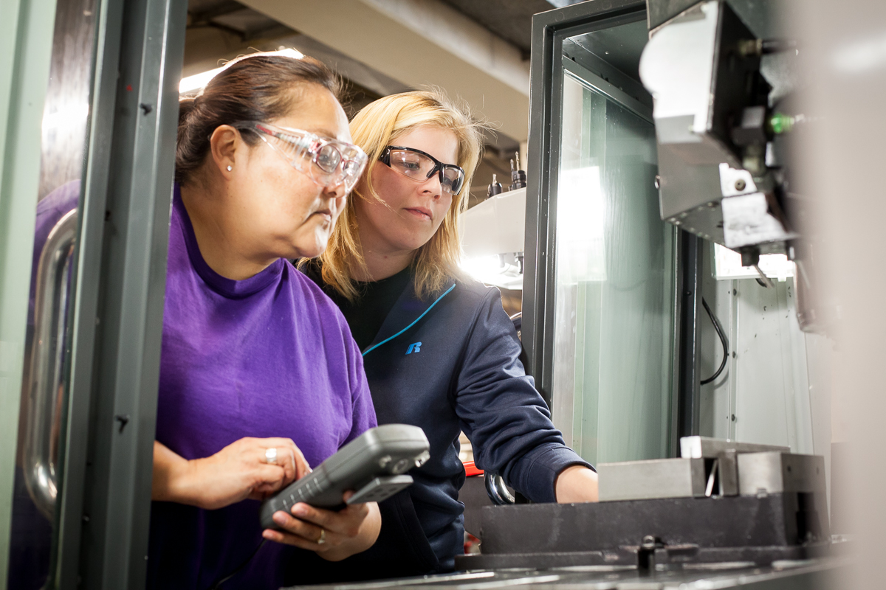
CURRICULUM DESIGN
Check that your curriculum:
Addresses sex-role and racial stereotypes, sexual harassment, and discrimination
Reflects the experiences of diverse populations
Include modules that address the needs of diverse populations:
Rights in the Workplace
Preventing and Addressing Sexual Harassment (see Tool 5.1)
Health and Safety of Women (see Tool 6.1)

Slide 19
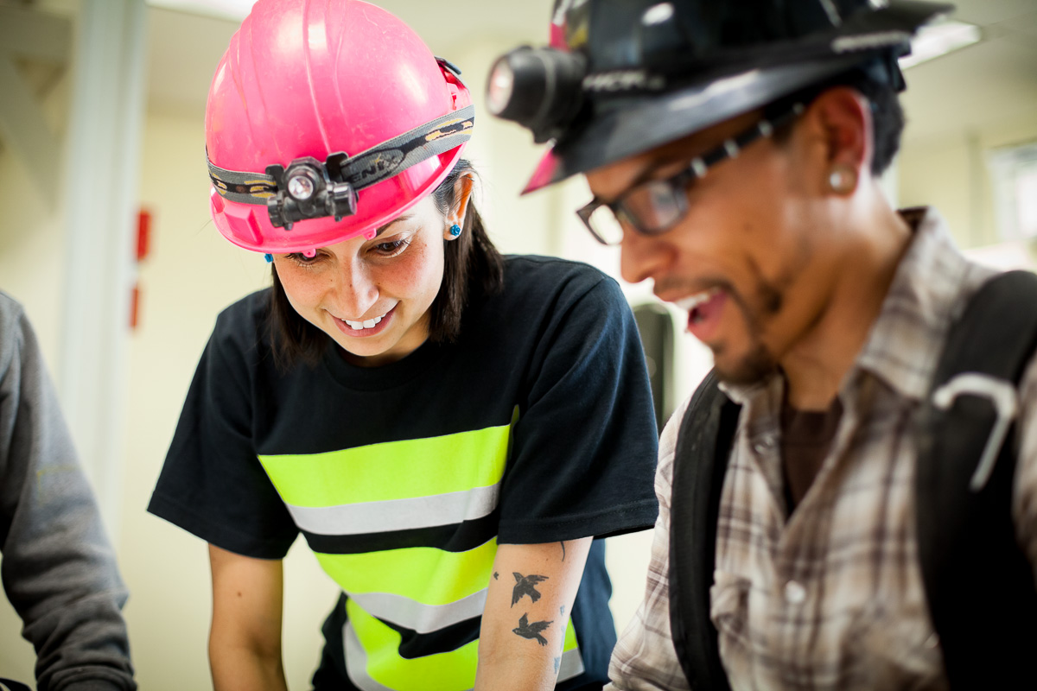
BEYOND CLASSROOM INSTRUCTION
INSTITUTIONAL POLICIES
Promote and enforce civil rights and sexual harassment policies and regulations.
Establish your program as a safe and supportive place for:
  Breaking down stereotypes
  Overcoming fear of the unknown
  Trying and practicing new things
  Networking with peers
Provide students with extra time and support if they need it to gain proficiency.

Slide 20
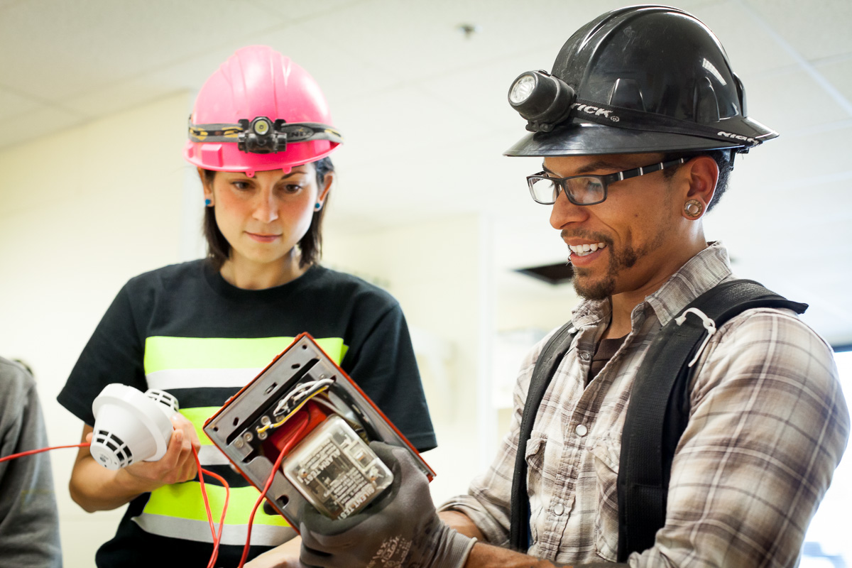
ESTABLISHING STUDENT SUPPORTS
Foster relationships with role models and mentors who reflect your students’ gender, race, and culture.
Facilitate informal support groups and peer counseling activities.
Avoid isolating an individual as the only student in the class who is woman or from an underrepresented group.
There is safety in numbers, as well as support!

Slide 21
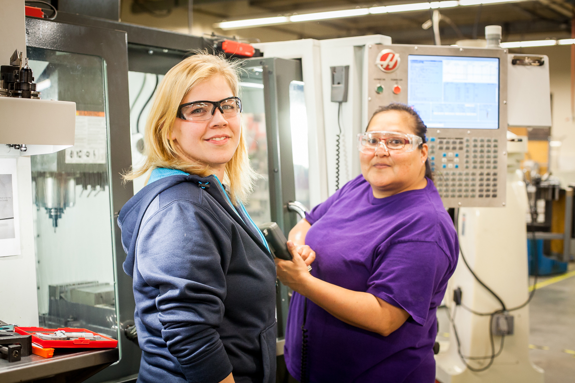
PROGRAM STAFF
Provide professional development activities that help staff examine their own beliefs and introduce a gender lens to the program.
Examine the program design for assumptions about the dominant culture that might not be true for non-dominant groups.
Engage a diverse teaching and support staff.

Slide 22

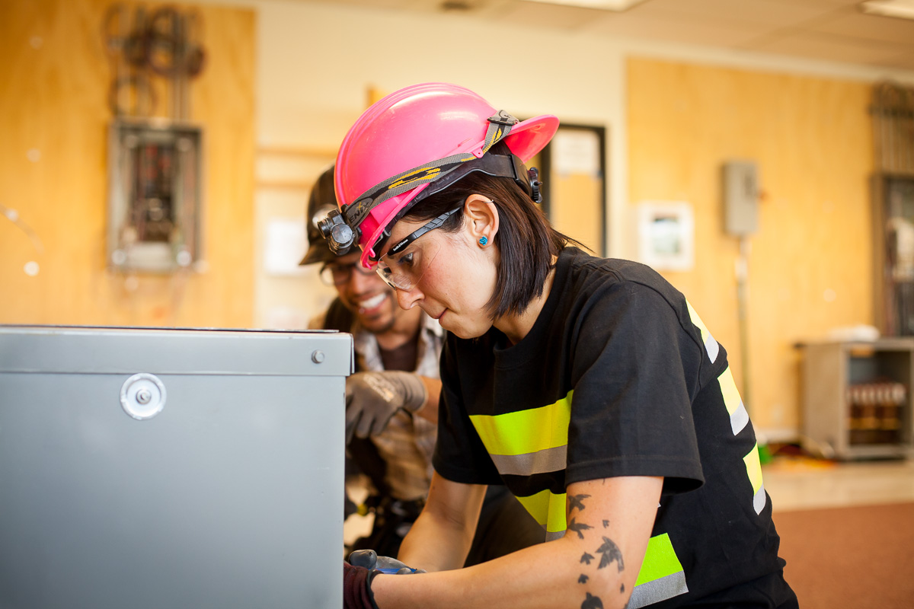
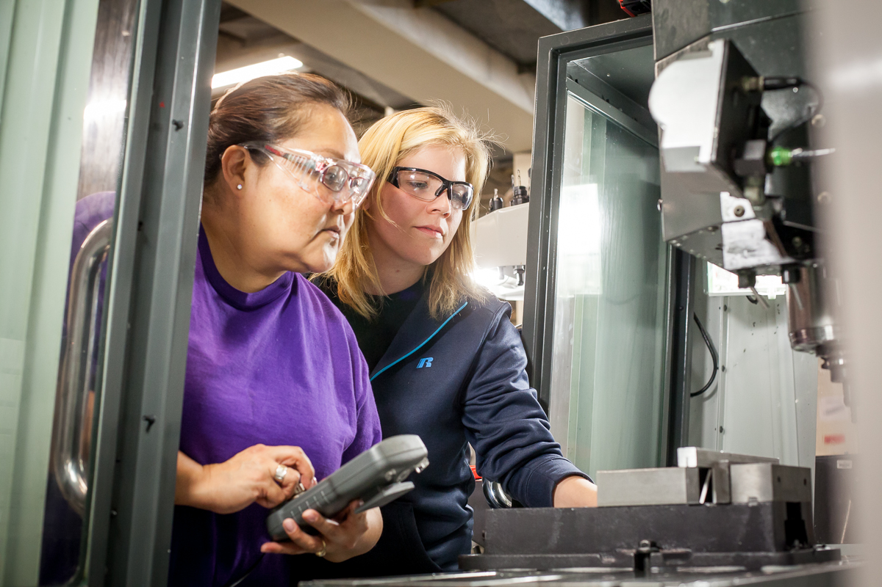
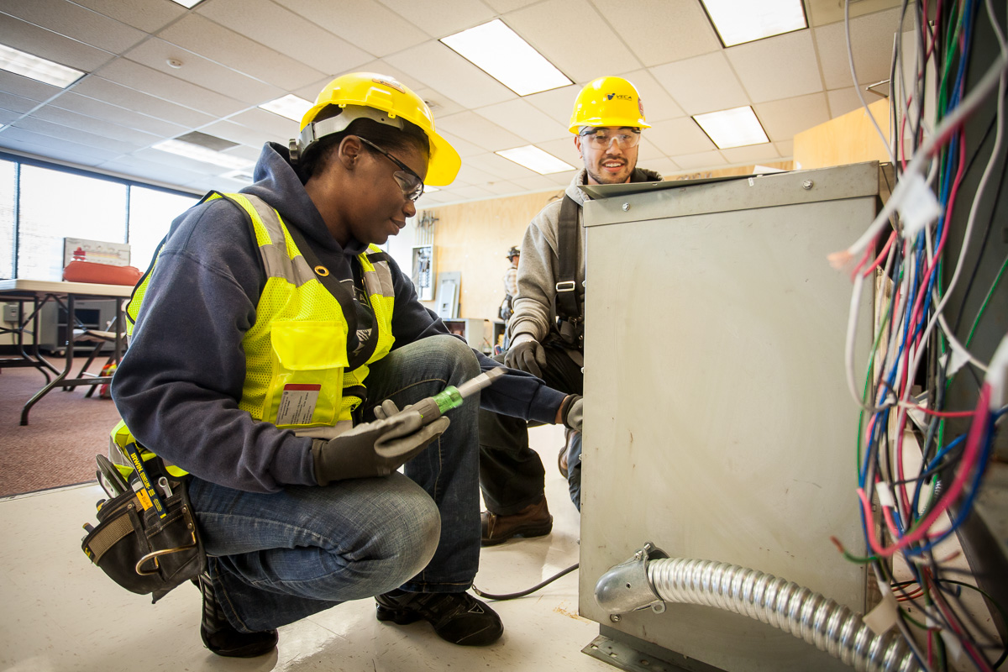
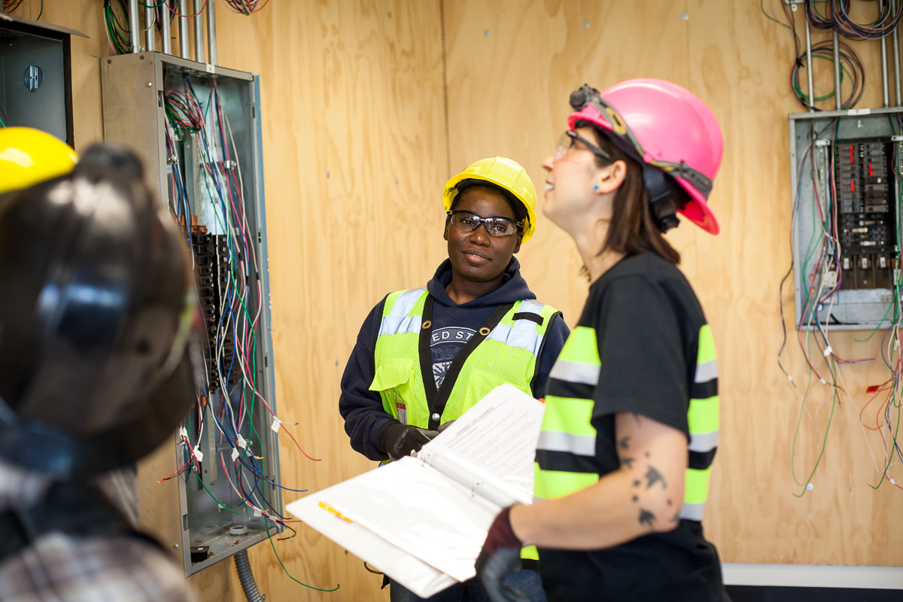
QUESTIONS AND DISCUSSIONS

Slide 23

This tool is part of Adding a Gender Lens to Nontraditional Jobs Training, created by Wider Opportunities for Women for the GreenWays initiative and revised by JFF as part of the Delivering the TDL Workforce initiative. All tools are available online at: http://www.jff.org/newlensonjobs.
Supported by the Walmart Foundation, Delivering the TDL Workforce expanded high-quality transportation, distribution, and logistics training programs in ten regions and promoted best practices in program design and delivery, employer engagement, and workforce partnership development. GreenWays was supported by grants from the U.S. Department of Labor through Pathways Out of Poverty and the Green Jobs Innovation Fund.
Jobs for the Future (JFF) is a national nonprofit that builds educational and economic opportunity for underserved populations in the United States. JFF develops innovative programs and public policies that increase college readiness and career success and build a more highly skilled, competitive workforce. With over 30 years of experience, JFF is a recognized national leader in bridging education and work to increase economic mobility and strengthen our economy.
WWW.JFF.ORG

