Slide 1

ADDING A GENDER LENS TO NONTRADITIONAL JOBS TRAINING
^{APRIL 2017}
CREATED BY WIDER OPPORTUNITIES FOR WOMEN
TOOL 3.11
BUILDING SUCCESSFUL INTERVIEWING SKILLS FOR APPRENTICESHIP
AND NONTRADITIONAL INDUSTRY EMPLOYMENT
This tool is part of Adding a Gender Lens to Nontraditional Jobs Training, created by Wider Opportunities for Women for the GreenWays initiative and revised by JFF as part of the Delivering the TDL Workforce initiative. All tools are available online at: http://www.jff.org/newlensonjobs.
Supported by the Walmart Foundation, Delivering the TDL Workforce expanded high-quality transportation, distribution, and logistics training programs in ten regions and promoted best practices in program design and delivery, employer engagement, and workforce partnership development. GreenWays was supported by grants from the U.S. Department of Labor through Pathways Out of Poverty and the Green Jobs Innovation Fund.

Slide 2

LEARNING OBJECTIVES
STUDENTS WILL BE ABLE TO:
Explain the importance of interviews in the application and hiring process.
Explain the interview process and expectations.
Prepare for an interview and respond to interview questions.
Demonstrate positive body language and non-verbal behavior.
Demonstrate effective interviewing skills.
Address interview questions that may
not be legal.
Identify communication styles related to gender.

Slide 3

WHY ARE INTERVIEWS USED?
To gain firsthand knowledge of a candidate.
To give industry members an opportunity to assess a candidate’s behavior, attitude and appearance.
To determine if an interviewee is a promising candidate for apprenticeship or employment with a company.

Slide 4

WHEN ARE INTERVIEWS USED?
INTERVIEWS ARE CONDUCTED:
As part of the apprenticeship selection process
Conducted after an aptitude test
Following written application by a candidate for a job or entry into an apprenticeship
On a jobsite by a superintendent or crew leader to fill a position
At a job fair following program graduation

Slide 5

WHAT TO EXPECT IN AN INTERVIEW
Apprenticeship Interviews are generally conducted by a panel that includes representatives of the employer and the union.
Interviewers are most likely volunteers conducting multiple interviews in the course of a day.
Interviews may last 5-20 minutes—be mindful of the time allotted for your interview.
Interviewers generally ask standard questions of all applicants.
An interview is a subjective measure— there may be guidelines but interviewers rely on their own perceptions and judgment.

Slide 6
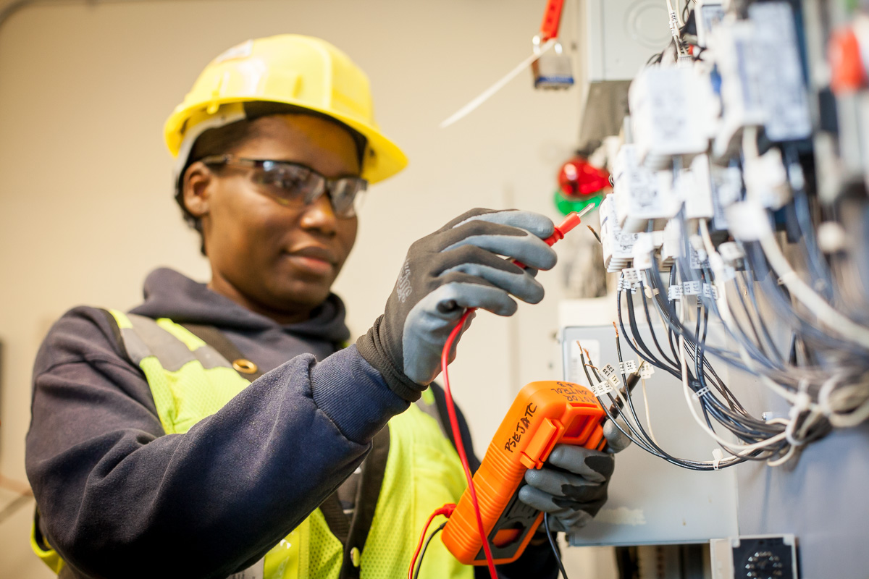
DO NOT EXPECT
That interviewers will try to make you comfortable
That interviewers will try to make you uncomfortable or ask trick questions
That you need to demonstrate in-depth technical skill or knowledge related to the role you are applying for
That the committee members will demonstrate any responsiveness to your replies
That you will get any immediate feedback
That all interviewers will be well trained in conducting an interview.

Slide 7
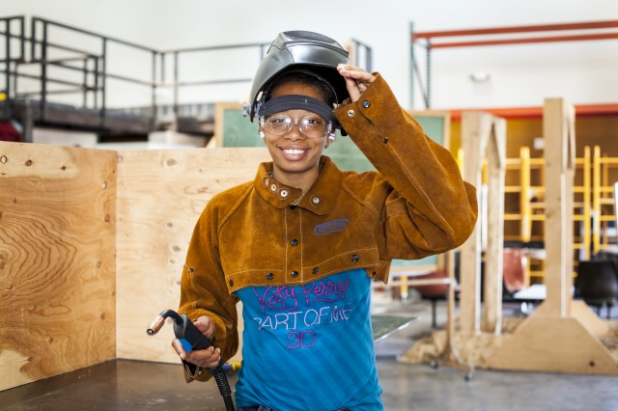
WHAT THEY ARE LOOKING FOR
Candidates that are a good fit—meaning a
candidate that:
Appears to have the physical, emotional, and intellectual aptitude to succeed in the apprenticeship program
Can demonstrate knowledge of the occupation
Can provide responsive, clear, and articulate answers to a variety of basic employment related questions
Appears enthusiastic, energetic, and
willing to learn
Demonstrates determination, dedication, and full commitment to a career in the target occupation
Has the ability to perform under pressure with high productivity and quality
Presents themselves as cooperative, and as someone who can work with others successfully, and can take direction

Slide 8
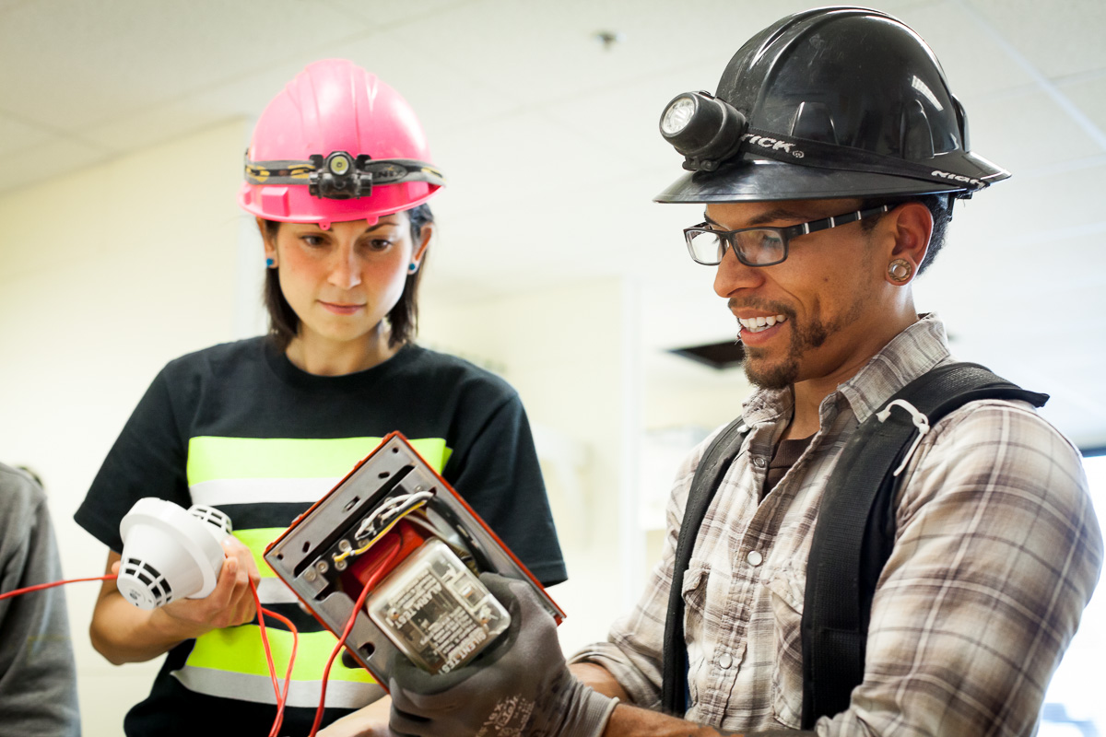
WHAT ARE APPRENTICESHIP PROGRAMS LOOKING
FOR—MOST IMPORTANTLY
Are you willing to put in the effort to complete an apprenticeship and work as a journeyperson?
Is it worth making an investment of the apprenticeship’s resources in you?
Can you demonstrate a commitment to completing an apprenticeship and making a career in the occupation?
Will you stay long enough to contribute to the good of the industry/trade equal to the investment in your training?

Slide 9

HOW ARE THESE QUALITIES MEASURED
They will rate—
Your responses to questions
Observation of your behavior and appearance
Assessment/impression about your attitude and energy
How much you know about the occupation
Perception of your level of interest and commitment to the occupation
Remember: An interview is a
subjective measure

Slide 10

WHAT THEY ARE LOOKING FOR: COMMUNICATION STYLE
Engaged listening and comprehension of the question
Answering questions asked with specific, to the point, related examples
Avoiding yes or no answers
Ability to think on your feet
Full sentences
Clear voice—loud enough but not too loud
Intonation—don’t speak in
a monotone.

Slide 11
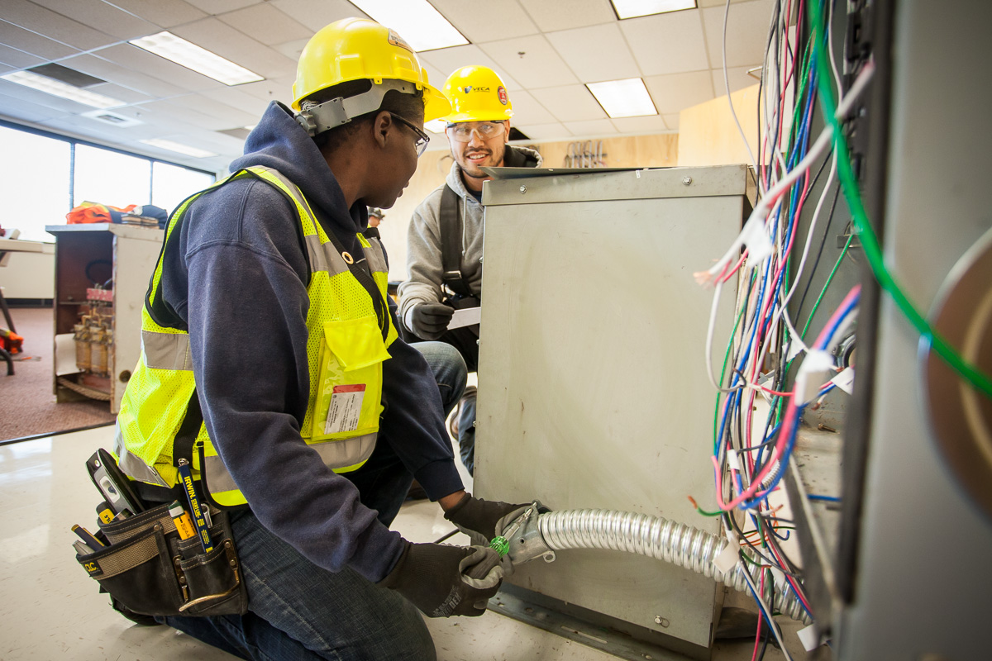
WHAT THEY ARE LOOKING FOR: ATTITUDE/BEHAVIOR
Timeliness
Preparation
Enthusiasm
Energy
Respectful
Appropriate
Attentive to the task
Positive
Committed
Sincerity, Honesty, Ethical
Confidence not Arrogance

Slide 12
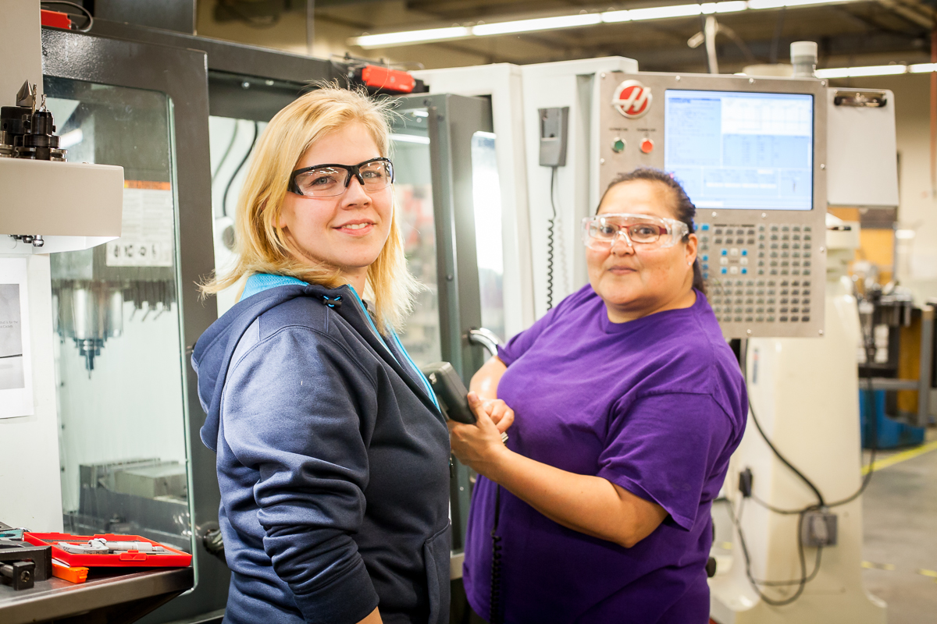
WHAT THEY ARE LOOKING FOR: NON-VERBAL SIGNALS
Appearance
Grooming
Eye contact
Calm and collected
Posture
Facial expressions
Handshake
Walk
Arm and hand movement,
and placement
Nodding while listening
Smiling

Slide 13

WHAT THEY ARE LOOKING FOR: KNOWLEDGE, SKILLS, AND ABILITIES
Ability to describe the duties and working conditions of the occupation.
Ability to describe the qualifications and characteristics of a model apprentice/employee.
Basic technical understanding of the occupation.
Demonstrate understanding of the apprenticeship program.
Provide information/documents requested.

Slide 14
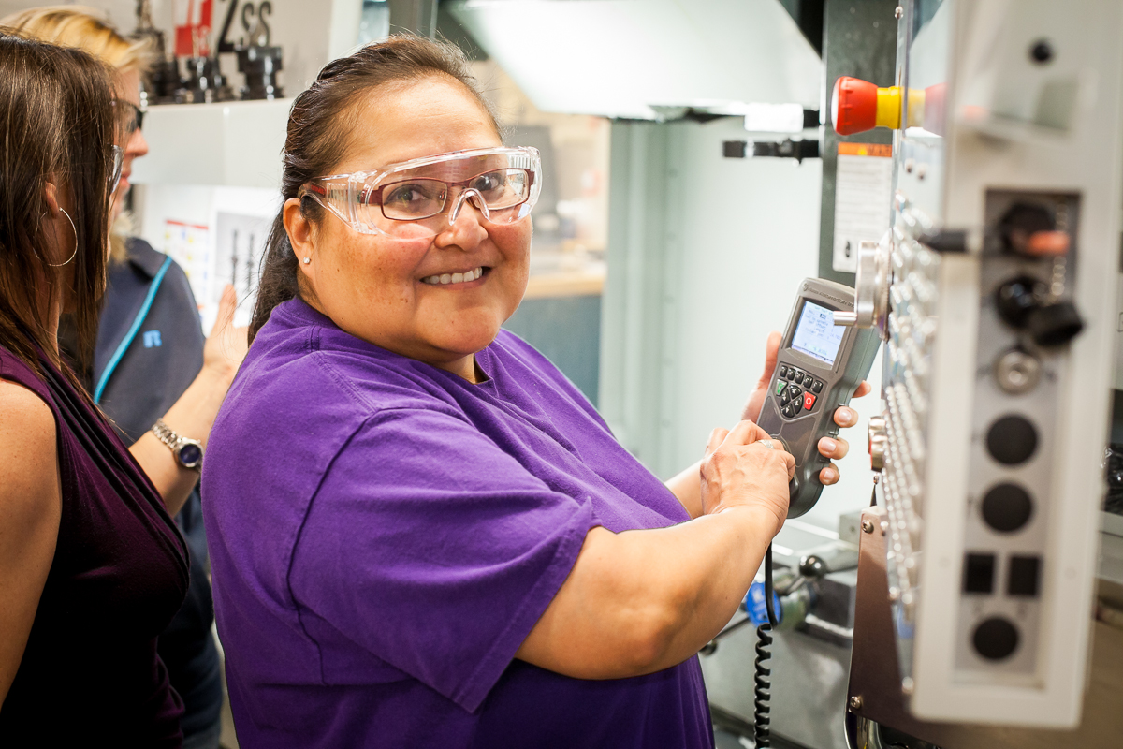
WAYS TO ACE AN INTERVIEW
Arrive on time
Speak confidently and clearly
Answer questions thoroughly without rambling
Demonstrate knowledge of the occupation and apprenticeship structure
Make a good first impression with a firm handshake, confident stride, and upright posture
Make the interviewers feel comfortable and connected to you
Be memorable for the right reasons: your commitment, interest, enthusiasm, and energy.

Slide 15

WAYS TO FAIL AN INTERVIEW
Showing up late
Hemming and hawing
Avoiding or dismissing a question
Inability to answer questions coherently
Not exhibiting knowledge of the occupation and apprenticeship structure
Unkempt appearance, inappropriate dress, distracting body art and jewelry
Bad posture
Inappropriate language
Disrespect
Acting disinterested, nonchalant, aggressive or over-confident
Being confrontational or dismissive

Slide 16

BASIC TIPS FOR MAKING YOUR INTERVIEW COUNT
Be prepared and practiced
Mention the training program and your accomplishments in it or other related training
Be yourself—be authentic
Do not give superficial or only
yes/no answers
Be relatable—do not be intimidated
by superficial differences of race
and gender
Don’t ramble

Slide 17
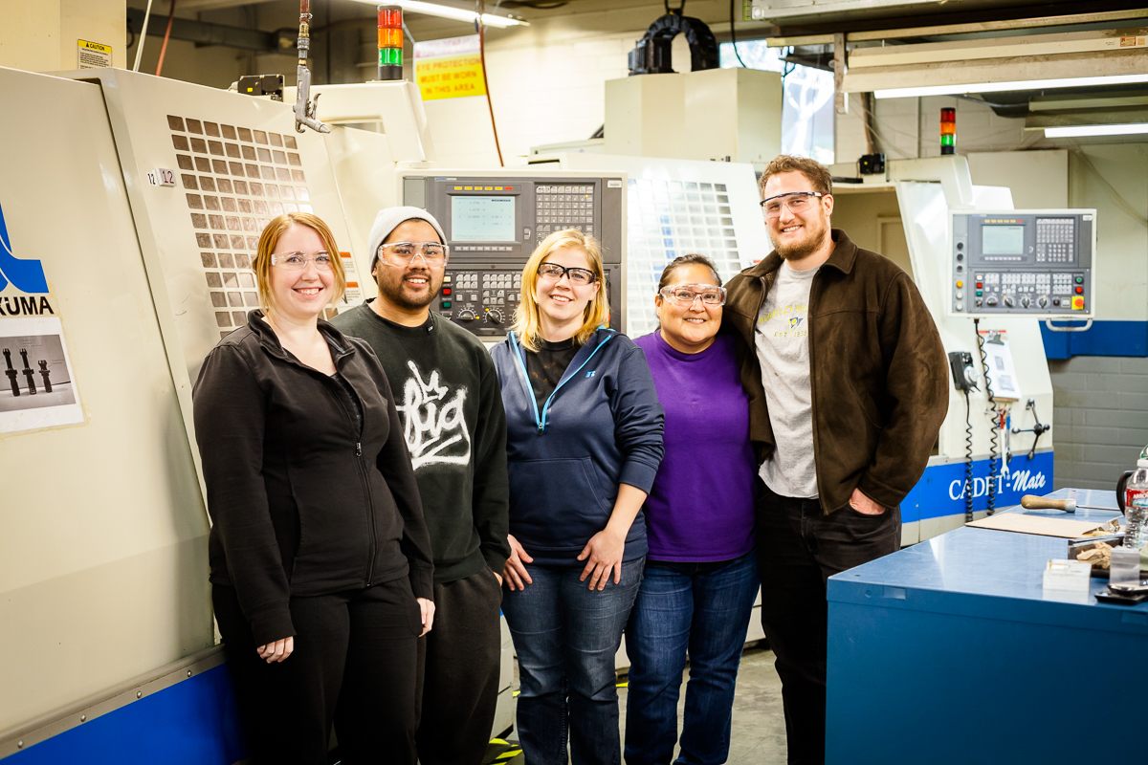
BASIC TIPS FOR MAKING YOUR INTERVIEW COUNT
Arrive at least 15 minutes ahead of time.
Make time to get your appearance ready—good grooming, neat, and conservative clothing.
Be likable—even if they forget what you say, they will remember if they liked you.

Slide 18

GIVE SPECIFIC EXAMPLES
I’m dependable—I maintained perfect attendance in my training program
Say more than just
“I’m a hard worker”
Use compliments you have received from co-workers/supervisors as examples
Highlight awards, promotions, or other recognition of your work

Slide 19
GENDER DIFFERENCES IN COMMUNICATION STYLES
I’m dependable—I maintained perfect attendance in my training program
Say more than just
“I’m a hard worker”
Use compliments you have received from co-workers/supervisors as examples
Highlight awards, promotions, or other recognition of your work
Interviewers may perceive
a candidate exhibiting these traits:
As less enthusiastic
Less prepared for the interview
Less committed to pursuing a career in nontraditional roles
Less capable of succeeding in an apprenticeship
Lacking in intellectual sophistication.

Slide 20

SAMPLE INTERVIEW QUESTIONS
Describe how you have handled situations in your life that are relevant to success on the job.
Why does this occupation appeal to you over some other occupation?
What makes you confident you can handle working in a male-dominated environment?
Do you have any paid or unpaid work experience or hobbies that relate to this occupation?
What are the strengths you have that will make you successful in this occupation?
Why should we select you for this highly competitive opportunity?

Slide 21

EXAMPLES OF ILLEGAL QUESTIONS
What year did you graduate from high school?
Where were you born?
What are your child care arrangements?
What are your religious practices?
How many days did you miss because of illness last year?
Do you have any disabilities?
Have you ever been arrested?
Are you planning to have children anytime soon?
Do you have parents or other family members dependent on you?

Slide 22
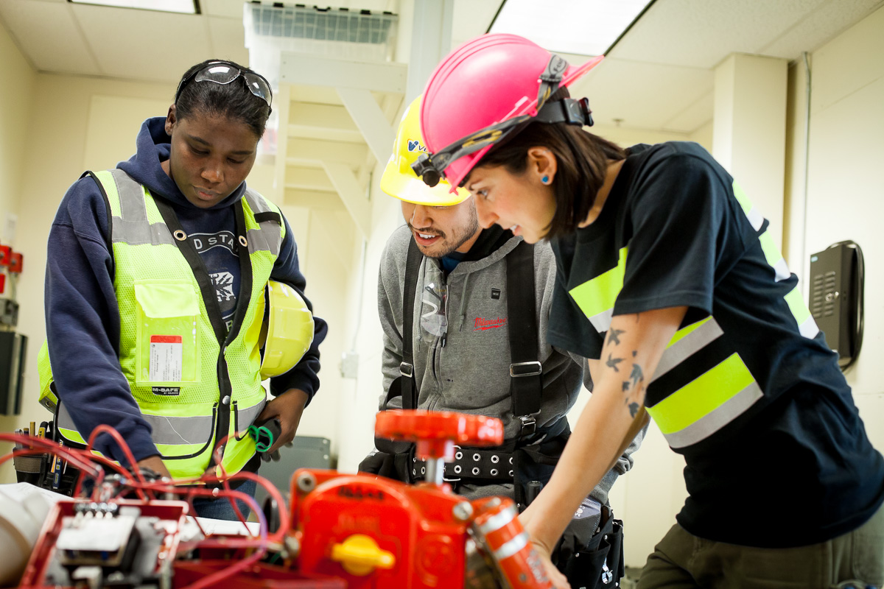
REVIEW AND SUMMARY
Be prepared and practiced
Arrive early
Make a good first impression
Speak confidently and clearly
Answer questions thoroughly and specifically
Exhibit your knowledge of the occupation
Make the interviewers feel comfortable
Be memorable for the right reasons: show your commitment, interest, enthusiasm, and energy!

Slide 23

This tool is part of Adding a Gender Lens to Nontraditional Jobs Training, created by Wider Opportunities for Women for the GreenWays initiative and revised by JFF as part of the Delivering the TDL Workforce initiative. All tools are available online at: http://www.jff.org/newlensonjobs.
Supported by the Walmart Foundation, Delivering the TDL Workforce expanded high-quality transportation, distribution, and logistics training programs in ten regions and promoted best practices in program design and delivery, employer engagement, and workforce partnership development. GreenWays was supported by grants from the U.S. Department of Labor through Pathways Out of Poverty and the Green Jobs Innovation Fund.
Jobs for the Future (JFF) is a national nonprofit that builds educational and economic opportunity for underserved populations in the United States. JFF develops innovative programs and public policies that increase college readiness and career success and build a more highly skilled, competitive workforce. With over 30 years of experience, JFF is a recognized national leader in bridging education and work to increase economic mobility and strengthen our economy.
WWW.JFF.ORG

