Slide 1

ADDING A GENDER LENS TO NONTRADITIONAL JOBS TRAINING
^{APRIL 2017}
CREATED BY WIDER OPPORTUNITIES FOR WOMEN
TOOL 2.1
ASSESSMENT AND CASE MANAGEMENT STRATEGIES TO SUPPORT WOMEN’S PARTICIPATION AND SUCCESS IN NONTRADITIONAL JOBS
This tool is part of Adding a Gender Lens to Nontraditional Jobs Training, created by Wider Opportunities for Women for the GreenWays initiative and revised by JFF as part of the Delivering the TDL Workforce initiative. All tools are available online at: http://www.jff.org/newlensonjobs.
Supported by the Walmart Foundation, Delivering the TDL Workforce expanded high-quality transportation, distribution, and logistics training programs in ten regions and promoted best practices in program design and delivery, employer engagement, and workforce partnership development. GreenWays was supported by grants from the U.S. Department of Labor through Pathways Out of Poverty and the Green Jobs Innovation Fund.

Slide 2
Improving the success of women requires not only recruiting them into job training programs but also incorporating a gender lens in the program design. This presentation can be used as part of a training session for the staff of workforce development programs responsible for assessing program candidates and providing case management to participants. The slides begin with assessment techniques to help select candidates who are likely to succeed. The assessment section includes sample questions and criteria. The case management section highlights topics that benefit from a gender lens, including support services and career planning. It reviews the responsibilities and qualifications of a strong case manager. It also introduces the concept of family economic security, along with tools to incorporate that into case management.
This presentation builds on Tool 1.2, Moving Women into Nontraditional Jobs and Industries. Tool 1.2 focuses on recruiting women and smoothing their intake into a training program. This presentation picks up where Tool 1.2 leaves off and is intended to train staff in case management for women after entering the program.
WHO SHOULD USE THIS TOOL
Training program directors; trainers of staff responsible for participant selection and intake; case managers; soft skills and financial literacy instructors
ACKNOWLEDGEMENTS: This presentation was originally presented as a webinar to GreenWays sites as part of the Pathways Out of Poverty grant in 2010. Special thanks to the original presenters, Geri Scott, JFF; Lauren Sugerman, Donna Addkison, and Camille Cormier, WOW; Connie Ashbrook, Oregon Tradeswomen Inc.; Deanna Hodges, Chicago Women in Trades.

Slide 3
AGENDA
  OVERVIEW OF GENDER EQUITY ISSUES
  PROGRAM STRATEGIES
  Assessment with a Gender Lens
  Case Management with a Gender Lens
  BEST as a Case Management Tool
  QUESTIONS AND DISCUSSION
3

Slide 4


OVERVIEW OF GENDER EQUITY ISSUES
GENDER LENS QUIZ
  Name three stereotypically female skills that might be transferable to a job in a nontraditional industry, such as construction or transportation.
  Identify three stereotypically female-dominated jobs that can pose challenges to maintaining and balancing work and family needs.
  Name three issues that might be more prevalent for women in case management.
4

Slide 5
MYTHS AND FACTS
MYTHS | FACTS
Women aren’t interested in nontraditional jobs. | Women in the past performed many jobs now thought to be nontraditional for women. Women who have not considered the possibility of these jobs for themselves often are quite interested in exploring them more once they are introduced to the opportunities.
Women won’t tolerate the working conditions in male-dominated blue-collar jobs. | Many women enjoy working with their hands and working outdoors. They take pride in knowing they helped build or create something. Many tradeswomen report a high degree of job satisfaction. And working conditions in traditionally female jobs may be equally challenging.
Women’s family responsibilities interfere with the working conditions and hours of nontraditional jobs | Most working parents manage work and family responsibilities. Programs can link women to resources to help identify support services for child care.
5
Notes:
Should this match slide 13 in tool 1.2? DIK: Stylistically, yes. But I like that this is different content, to make the idea of myths more robust.

Slide 6


ASSESSMENT WITH A GENDER LENS
KEY COMPONENTS OF ASSESSMENT
  Conducting assessment with a gender lens
  Understanding what kind of candidates your program is looking for
  How to retrieve information from prospective clients
  When to assess candidates
  Who should be involved in assessing candidates
  Using assessment to set the stage for case management
6
6

Slide 7
PUTTING A GENDER LENS ON ASSESSMENT
  ASSESSMENT SHOULD HELP CLIENTS TO:
  Get past the unknown
  Assess their fit for the job training program
  Identify transferable skills
  Become aware of work/family issues
  Demonstrate their commitment and ability to follow directions
  Experience aspects of working tasks and responsibilities
  ASSESSMENT SHOULD ENABLE STAFF TO:
  Raise questions about a candidate’s fit for the program in a non-judgmental way
  Ask probing questions to go beyond stereotypes
  Identify case management needs
  Measure basic skill levels and job readiness to determine how best to serve the applicant
7

Slide 8

TIPS FOR A SUCCESSFUL ASSESSMENT
  Use probing questions.
  Minimize yes or no questions.
  Ask about previous experiences.
  Tease out information on transferable skills from paid and unpaid work experiences.
  Encourage self-assessment.
  Do not be judgmental.
8

Slide 9

SAMPLE ASSESSMENT QUESTIONS—GENERAL
  How will you maintain a sense of humor when dealing with difficult people?
  Give me an example of a challenge you overcame.
  How will you feel if you are the only woman doing your job?
  Apart from a good income, what else do you think would bring you satisfaction from a job?
  What do you expect your day to be like on the job?
  Are you safety-conscious in all your work?
9

Slide 10
SAMPLE ASSESSMENT QUESTIONS—CONSTRUCTION
  Why do you want to work in construction or the construction-related industry? What makes you a good candidate for this type of work?
  Describe a time when you worked with others as a team to build a project.
  How do you know you can work in physically demanding environments that may be extremely noisy, dirty, hot, cold, wet, smelly, or potentially dangerous?
  What do you do when repairs are needed around your home (such as fixing outlets, toilets, or leaks)?
  Have you worked from a pattern, blueprint, or diagram to construct or make things? Example?
  Do you like to start and end your workday early?
10

Slide 11
SAMPLE ASSESSMENT QUESTIONS—TRUCKING
  Why do you want to work as a trucker? What makes you a good candidate for this type of work?
  Do you have experience stick shifting?
  Are you comfortable being away from home for extended periods?
  Can you describe an experience for which you kept good records?
  Would you describe yourself as self-motivated and, if so, why?
11

Slide 12
SAMPLE ASSESSMENT QUESTIONS—LOGISTICS
  Why do you want to work in logistics or warehousing? What makes you a good candidate for this type of work?
  Can you provide an example that shows you are detail oriented and organized?
  Do you have basic computer skills and experience using software?
  How well do you work on teams?
  Do you feel comfortable operating heavy machinery?
  Do you regularly drive a vehicle? (Driving can serve as a useful proxy that students will be able to operate trucks, forklifts, and other equipment.)
12

Slide 13

SAMPLE ASSESSMENT EVALUATION CRITERIA
  Does the applicant understand the nature of the work and the working conditions?
  Does the student have (or can gain) the physical capacity to succeed in a job that requires physical labor?
  How well can the applicant follow directions?
  Does the applicant have a good attitude about entering a male-dominated work environment?
  Has the applicant demonstrated commitment to the program by showing up at various assessment points?
  Does the applicant have strengths that balance out the weaker areas?
  Does the student follow dress code?
  Are the student’s mathematical skills at the level necessary for her to succeed in her trade choice?
  Do applicants have experiences in their history (not necessarily in their job history) that suggest they’re a good fit for the role?
13

Slide 14
EMPLOYER ENGAGEMENT IN ASSESSMENT
  Benefits for Client
  Exposure to real employers
  Hearing directly from employers on what they are looking for in an employee
  Benefits for Employers
  Meeting clients
  Pre-screened applicants
  Benefits for Program
  Employer investment
  Feedback for program
14

Slide 15

EXPERIENCED MENTORS ARE VERY IMPORTANT FOR WOMEN ENTERING NONTRADITIONAL INDUSTRIES
Engaging experienced tradesmen and tradeswomen in the assessment process builds allies, resources, and connections for aspiring tradeswomen.
15
Notes:
Having supportive men is critical. Cultivate strong relationships with industry representatives.

Slide 16

CASE MANAGEMENT WITH A GENDER LENS
KEY ASPECTS OF CASE MANAGEMENT:
SUPPORTING THE CLIENT FROM ASSESSMENT TO RETENTION
  Putting a Gender Lens on Case Management
  Individual Goal Setting & Career Planning
  Support Services
  Tracking & Follow-up
  Case Manager: A Job Description
  Integrating Case Management into All
  Aspects of Program Services
16

Slide 17
CASE MANAGEMENT GOALS FOR PARTICIPANTS
  Increased competency in developing the skills necessary to become a viable candidates for apprenticeship programs
  Empowered to function as independently as possible
  Linked with essential resources
  Enhanced self-confidence so she is better equipped to face the challenges of a career in a male-dominated industry
17

Slide 18
PUTTING A GENDER LENS ON CASE MANAGEMENT
  Building self-esteem
  Balancing work and family
  Planning child care
  Addressing a lack of family support
  Addressing domestic violence, spousal control issues
  Countering test-taking anxiety
  Surviving and thriving in a male-dominated work environment
  Building physical fitness and healthy habits
  Budgeting and financial literacy
18

Slide 19
STAGES OF CASE MANAGEMENT
  Individuals need case management throughout their involvement with your organization. Provide services when
  they are:
  Applicants preparing for admission to the training program
  Training program participants
  Job-ready candidates who do not require additional training
  Program graduates
  Programs can make their services more robust by:
  Integrating case management into all aspects of program services
  Coordinating case management with all program staff
19

Slide 20



INDIVIDUAL GOAL SETTING & CAREER PLANNING
  Begin with developing a career plan.
  Outline participants long- and short-term goals.
  Identify activities, barriers, and services needed to achieve these outcomes.
  Use an in-class goal-setting workshop to provide participants with the tools to begin formulating goals and plans.
  One-on-one case management provides essential guidance in helping students weigh the merits of various opportunities and create achievable career plans with realistic goals, timelines, and activities.
  The plan provides a framework for staff in supporting participants toward progress in meeting their goals.
  Ongoing check-ins: Participants must attend a second one-on-one during the last few weeks of class to reevaluate the career plan and identify next steps toward apprenticeship.

Slide 21
SUPPORT SERVICES
  Connect participants with resources from the program and other sources for overcoming barriers and achieving success. Can include:
  Housing
  Child care
  Legal services
  Drivers license restoration
  Dealing with domestic violence
  Important for participants take charge of this process
  Staff members provide participants with a resource booklet and work with them to access services.
  Support service needs are consistent with those of other low-income participants in the programs EXCEPT entering an apprenticeship program can be very lengthy and expensive:
  Unpaid pre-apprenticeships after acceptance
  Payment of initiation fees prior to placement
  Health exams
  Tool and clothing costs
  Consider how the program can provide financial subsidies to participants through small grants, no-interest loans, or other ways.
21

Slide 22
TRACKING & FOLLOW-UP
TRACKING
  Tracking participants via completion of biweekly, mid-term, and final progress reports on:
  performance on tests;
  submission of homework; and
  attendance
  Allows case management to quickly identify and respond to any issues or progress reported
  If participant is not meeting requirements, case management initiates contact and works to identify and assist the participant in solving issues that impede class attendance or achievement.
  Make/maintain personal connection
  FOLLOW-UP
  For those interested in further training or union membership:
    Apprenticeship application status sheet tracks applicants’ interest in and applications to apprenticeship programs.
    Follow-up with participants reminds them of application openings for apprenticeships or jobs.
    Invite them to study sessions for upcoming tests
    Support them in following through with applications and/or tests and interviews
    Capture outcomes
22

Slide 23
JOB DUTIES: CASE MANAGER
  Monitor participant progress.
  Provide limited counseling for career exploration, encouragement, coaching, identifying barriers, and goal setting.
  Facilitate access to and assess eligibility for support services as needed to promote program retention and facilitate transition to the nontraditional workplace.
  Help clients navigate the processes that lead to entry into and sustained success in nontraditional careers.
  Coordinate referral and follow-up with participants, service providers, and employers.
  Participate in applicant screening and in program decision-making processes.
  Track and provide counseling and support services to program participants referred to training programs.
  Engage program graduates in post-class activities, such as a job club.
  Create and maintain participant files in electronic from and as hard copy in cooperation with other team members.
  Work with other team members to assess the status of client progress and determine the best ways to help each client reach her goals.
23

Slide 24
QUALIFICATIONS: CASE MANAGER
  Understanding of workforce development issues and services
  Work experience in providing case management and counseling services
  Work experience in a setting characterized by socioeconomic, ethnic, and/or racial diversity
  Active-listening skills
  Ability to solve problems
  Resourcefulness
  Ability to take initiative within a team environment
  Commitment to women’s social and economic equity
  Flexibility to work some evenings and weekends
24

Slide 25
BASIC ECONOMIC SECURITY TABLES (BEST)
BEST AS A CASE MANAGEMENT TOOL
THE VALUE OF FINANCIAL LITERACY
  Strong case management not only prepares women for the workforce but also ensures that they can use their job to build financial stability. Include financial literacy in case management services in order to identify the level of resources necessary to support a family and to help women achieve their financial goals.
USING THE SELF-SUFFICIENCY STANDARD OR BASIC ECONOMIC SECURITY TABLES
MORE THAN NUMBERS
  Understanding the BEST Index
  How to use BEST
  Examples of BEST in action: tables
  For more economic security resources, see Preparing for the BEST: Economic Security and Career Literacy Resource Guide, prepared by WOW for JFF’s GreenWays initiative (July 2012). http://greenways.jff.org/sites/default/files/PreparingForTheBest_062912.pdf
25

Slide 26
THE BEST INDEX AND DIRECT SERVICE PROVIDERS/CASE MANAGERS
  A tool for counseling
  A way to determine eligibility
  A measuring stick for quality jobs
  A benchmark for client progress
  A resource for developing career paths
  A foundation for training programs
  A tool for financial education workshops
The BEST Index is a realistic measure of what it costs for working families to live in your community, including:
The costs and benefits of working; and
The amount of income needed without public or private supports.
The BEST Index:
Assumes all adults are working full-time, which are the realities of our world
Takes into account ages of children
Varies by geographical location
26
Notes:
Workforce Investment Boards (WIBs) across the country have defined and implemented the concept of self-sufficiency to further the goal of creating an economically sound and thriving community through a well-functioning workforce system. These include WIBs in AZ, CA, CT, IL, MA, MD, ME, MN, MT, OR, PA, UT, WA, and WI.
Workforce Investment Boards of Sacramento, Long Beach, Pasadena, San Francisco, Santa Cruz,
Contra Costa, Mendocino, San Bernardino, and Oakland have raised the eligibility criteria for intensive case
management and training services based on the Self-Sufficiency Standard. As a result, their employment and
training programs are available to more people in their communities.

Slide 27
USES OF THE BEST CALCULATOR
  Provides an added assist by simplifying budgeting
  Integrates work supports
  Enables customers to test different combinations of income and work supports
  Enables case managers to benchmark wages against local costs of living and more
ADDITIONAL BEST MEASURES
  Adds measures for asset building:
  Savings
  Emergencies
  Career education
  Retirement savings
  Building equity through home ownership
27
Notes:
Explain what calculator: BEST Calculator?

Slide 28
SELF-SUFFICIENCY WAGE BUDGET WORKSHEET
  Use this worksheet to find your ‘self-sufficiency wage”—the wage or salary necessary to meet your basic expenses.
Instructions: Please complete this worksheet based on the monthly costs associated with living on your own. COSTS (per month): | Family Members: # adults ___ # infants ___ # preschoolers ___ # school age ___ EXPENSES:
1. Housing
2. Utilities
3. Food
4. Transportation
5. Child Care
6. Personal and Household Items
7. Health Care
8. Taxes
Expenses Subtotal: Add Lines 1 through 8
9. Savings
Expenses with Savings Subtotal: Add Lines 1 through 9
 | Without Savings | With Savings
Monthly Self-Sufficiency Wage: Without Savings = Line A With Savings = Line B
Hourly Self-Sufficiency Wage: Without Savings = Divide Line A by 176 (average full-time hours per month) With Savings = Divide Line B by 176
Yearly Self-Sufficiency WAGE: Without Savings = Multiply Line A by 12 With Savings = Multiply Line B by 12
28

Slide 29
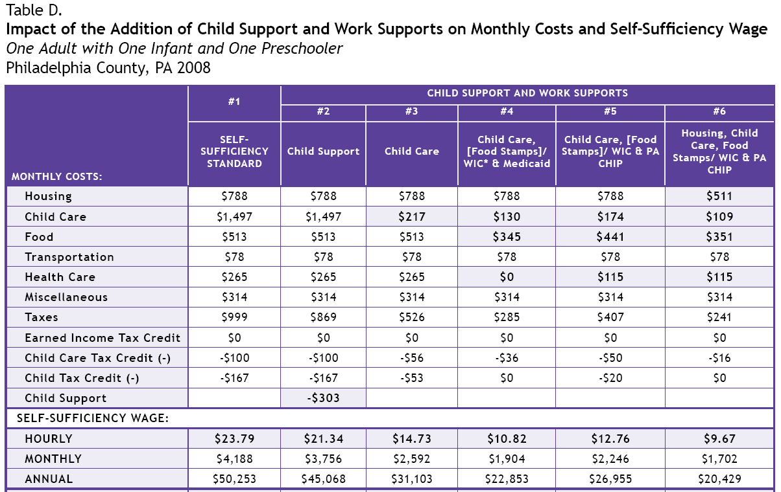
A MODELING EXAMPLE—PENNSYLVANIA
29

Slide 30
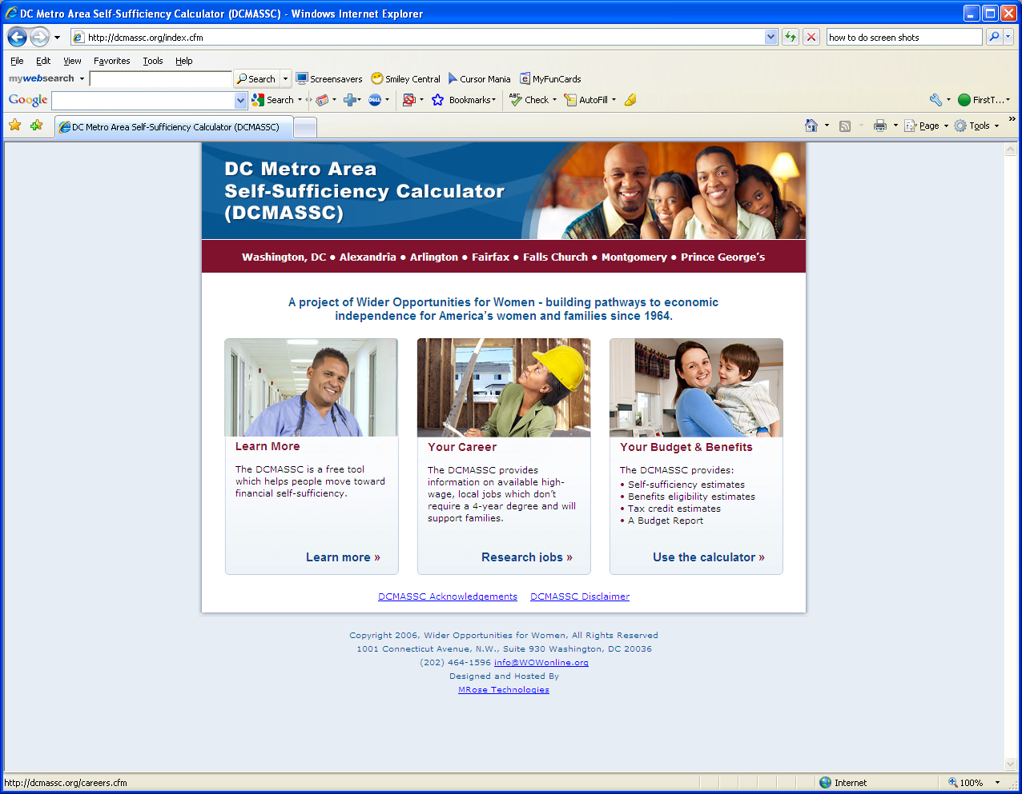
WASHINGTON, DC, METROPOLITAN AREA SELF-SUFFICIENCY CALCULATOR
30

Slide 31
FINANCIAL LITERACY
  Beyond general personal finance concerns, occupations can introduce unique financial hurdles. Aspiring truck drivers will have to navigate the following circumstances that, for example, would not apply to a manufacturing technician.
  On the Road Expenses
    There are few places truck drivers can eat besides truck stops or restaurants that have truck parking.
    It's difficult to make meals in the truck, and most drivers don't want to spend the time they have preparing meals.
    Eating meals out all the time can get unsustainably expensive.
    Drivers should save every food receipt as all meal costs on the road are tax deductible.
    They could also put a fridge or cooler in the truck, in which they can store groceries and leftovers.
  In the trades, Port Jobs, a partner of the Delivering the TDL Workforce initiative, offers (for a fee) a trainer toolkit for teaching financial tools to apprentices, including instructor scripts, ready-made PowerPoint presentations, activities, and frequently asked questions.
  Entrepreneurship
    Company drivers are most often compensated per hour or per load.
    Companies typically make truck payments, insurance payments, and cover vehicle maintenance costs.
    Drivers who are able to anticipate their future income as well as their monthly rent, bills, and vehicle expenses are candidates to own their trucks.
    “Owner-Operators” bear more risk, but may also command higher
  In the trades, Port Jobs, a partner of the Delivering the TDL Workforce initiative, offers (for a fee) a trainer toolkit for teaching financial tools to apprentices, including instructor scripts, ready-made PowerPoint presentations, activities, and frequently asked questions.
    Provides an added assist by simplifying budgeting
    Integrates work supports
    Enables customers to test different combinations of income and work supports
    Enables case managers to benchmark wages against local costs of living and more
31
ASSESSMENT AND CASE MANAGEMENT STRATEGIES TO SUPPORT WOMEN’S PARTICIPATION AND SUCCESS IN GREEN JOBS

Slide 32

This tool is part of Adding a Gender Lens to Nontraditional Jobs Training, created by Wider Opportunities for Women for the GreenWays initiative and revised by JFF as part of the Delivering the TDL Workforce initiative. All tools are available online at: http://www.jff.org/newlensonjobs.
Supported by the Walmart Foundation, Delivering the TDL Workforce expanded high-quality transportation, distribution, and logistics training programs in ten regions and promoted best practices in program design and delivery, employer engagement, and workforce partnership development. GreenWays was supported by grants from the U.S. Department of Labor through Pathways Out of Poverty and the Green Jobs Innovation Fund.
Jobs for the Future (JFF) is a national nonprofit that builds educational and economic opportunity for underserved populations in the United States. JFF develops innovative programs and public policies that increase college readiness and career success and build a more highly skilled, competitive workforce. With over 30 years of experience, JFF is a recognized national leader in bridging education and work to increase economic mobility and strengthen our economy.
WWW.JFF.ORG

